Slide 1
Source: istock photo

Slide 3
10 Reasons Why Privacy Rights are Important

Slide 4
1
Privacy Rights prevent the government from spying on people (without cause)
2
Privacy Rights keep organisations from using personal data for their own goals
3
Privacy Rights help ensure those who steal or misuse data are held accountable
4
Privacy Rights help maintain social boundaries
5
Privacy Rights help build trust
6
Privacy Rights ensure we have control over our data
7
Privacy Rights protect freedom of speech and thought
8
Privacy Rights let you engage freely in politics
9
Privacy Rights protect reputations
10
Privacy Rights protect your finances

Slide 5
Data Privacy Trends in 2023

Slide 6
Global rise in data privacy regulations
Increase in requests and complaints of data subjects
More data security and privacy job positions
Companies will invest more in privacy technologies
A cookieless future
Greater transparency in the collection and processing of personal data

Slide 7
1. Global rise in data privacy regulations
The global rise in data privacy regulations will continue to rise in 2023. By the end of 2024, it is expected that 75% of the global population will have its personal information covered under privacy regulations.
2. Companies will invest more in privacy technologies
Privacy-enhancing technologies took the center stage in 2022 and will continue to rise in 2023. In 2019 Google launched Privacy Sandbox and is currently working on Trust token API and other privacy technologies to replace third-party cookies. In 2021 – 2022, big tech companies were charged with multi-million fines for the GDPR breaches. The total amount of fines appointed on Meta alone until the end of 2022 by the Irish Data Protection Commission for breaching the GDPR and ePrivacy Directive seeks nearly €1 billion. In addition, the Irish Data Protection Commission also has 40 open inquiries for other big tech companies. This tendency will continue in 2023, and we should see more companies charged with big fines for breaches of privacy regulations, especially the European ones.
Source: https://cookie-script.com/blog/data-privacy-trends-in-2023
http://www.pptback.com/flowers-abstract-gradient-yellow-flowers-pptbackground.html

Slide 8
3. A cookieless future
Google has announced that by the end of 2023, it will officially stop supporting Third-Party Cookies on the Google Chrome browser. The trend will continue for removing cookies in favor of consent-based data-collecting solutions.
4. Greater transparency in the collection and processing of personal data
User privacy survey shows that website users value data privacy, and over 50% of them would change service providers simply because of their data policies or data sharing practices. The trend will continue in 2023.
5. Increase in requests and complaints of data subjects
Data subjects of the privacy regulations are becoming more aware of their rights and want to protect their personal information. As data subjects continue to exercise their right to know, update, delete, or otherwise handle the personal information businesses have collected about them, this will follow by a significant increase in data subject requests and complaints in 2023.

Slide 9
6. More data security and privacy job positions
Increasing and changing privacy regulations worldwide will lead to more data security jobs for humans in the coming year. The increase in related jobs in recent years dispels the myth that Data Science and Artificial Intelligence replace human labor.
Source: https://cookie-script.com/blog/data-privacy-trends-in-2023

Slide 10
World's Biggest Data Breaches
Mar 2021
533,000,000 records lost.
Phone numbers, full names, locations, email addresses and biographical information on 533 million users from 106 countries. Scraped due to vulnerability ‘‘patched in 2019’’
Source: https://www.informationisbeautiful.net/visualizations/worlds-biggest-data-breaches-hacks/

Slide 11
Data Breaches exceeding 15,000,000 records lost
2021
2022
Source: https://www.informationisbeautiful.net/visualizations/worlds-biggest-data-breaches-hacks/

Slide 12
Data Protection and Privacy Legislation Worldwide

Slide 13
Data Protection and Privacy
137 out of 194 countries had put in place legislation to secure the protection of data and privacy.
Africa and Asia show different level of adoption with 61 and 57 per cent of countries having adopted such legislations.
The share in the least developed countries is only 48 per cent.
Source: https://www.videezy.com/
https://unctad.org/page/data-protection-and-privacy-legislation-worldwide

Slide 14
Guiding Principles
Source: Privacy and Personal Data Protection Guidelines for Africa

Slide 15
Key Considerations
Source: Privacy and Personal Data Protection Guidelines for Africa

Slide 16
AFRICA
Existing Privacy Laws and Frameworks in Africa
SADC Model Law on Data Protection (2010) – Under Review
ECOWAS Supplementary Act A/SA.1/01/10 on personal data protection (2010)
EAC Framework for Cyberlaws (2008)
African Union Convention on Cyber Security and Personal Data Protection (Malabo Convention)
Privacy & Personal Data Protection Guidelines for Africa
African Union Continental Data Policy Framework
The Digital Transformation Strategy for Africa (2020-2030)
African Continental Free Trade Area (AfCFTA) agreement
Source: https://www.teahub.io/viewwp/

Slide 17
European Union (EU)
The Evolving Landscape of European Data Privacy Laws
General Data Protection Regulation (GDPR)
Data Governance Act (DGA)
ePrivacy Directives
ePrivacy Regulation
Digital Markets Act
Digital Services Act
The Draft Data Act
European Health Data Space (EHDS)
Artificial Intelligence Regulation

Slide 18
Council of Europe (CoE)
Ratification of Mauritius to the Convention for the Protection of Individuals with regard to Automatic Processing of Personal Data (Convention 108) which came into force on 01 October 2016.
Ratification of the Protocol amending Convention for the Protection of individuals with regard to automatic processing of personal data on 04 September 2020.
Source: https://www.pinterest.com/

Slide 19
United Nations
United Nations International Covenant on Civil and Political Rights
Universal Declaration of Human Rights
UN Principles on Data Protection and Privacy
UN Reports of the Special Rapporteur on the Right to Privacy
Guidance Note on Data Privacy, Ethics and Protection for the United Nations Development Group (UNDG)
UNESCO’s Principles on Personal Data Protection and Privacy
United Nations High Commission on Human Rights’ resolution on The Right to Privacy in the Digital Age
Source: https://www.worldatlas.com/

Slide 20
American Data Privacy and Protection Bill, California Privacy Rights Act (2020), Consumer Data Protection Act (Virginia), Utah Consumer Privacy Act (UCPA), Connecticut Privacy Act, Colorado Privacy Act, (CPA), Children’s Online Privacy Protection Bill
US
UK
Data Protection Act 2018
Online Safety Bill
China
Personal Information Protection Law (PIPL)
India
Digital Personal Data Protection Bill 2022
Source: https://www.informationisbeautiful.net/visualizations/worlds-biggest-data-breaches-hacks/

Slide 21
Revenue Collected
Main Achievements of the Data Protection Office
DPO collected a total revenue of Rs 11,741,500 in 2021 and Rs 2,736,500 for registration of controllers and processors in 2022.

Slide 22
European Union Adequacy
In conjunction with the adequacy requirements established by the European Union, the office prepared and submitted a report to the European Commission (EC) Directorate for its study and perusal with a view to a subsequent adequacy finding for Mauritius. The report aims to provide an overview of the Mauritian system in order for the EC to conduct an objective assessment.

Slide 23
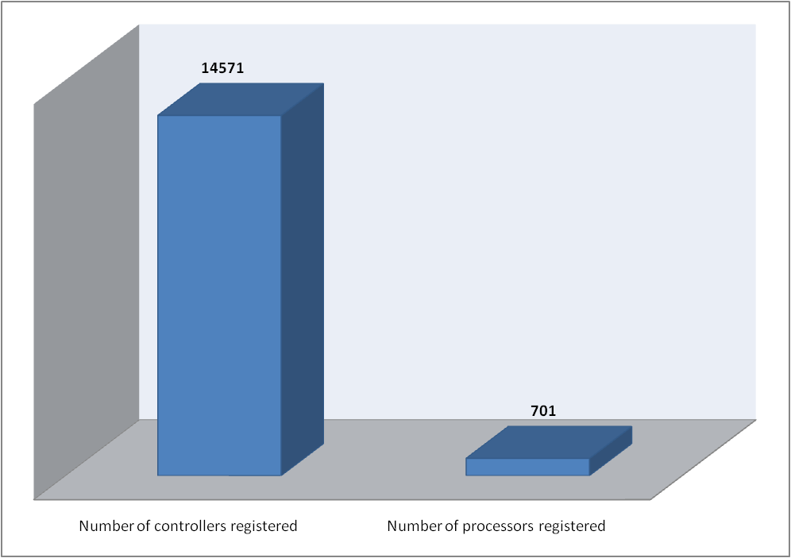
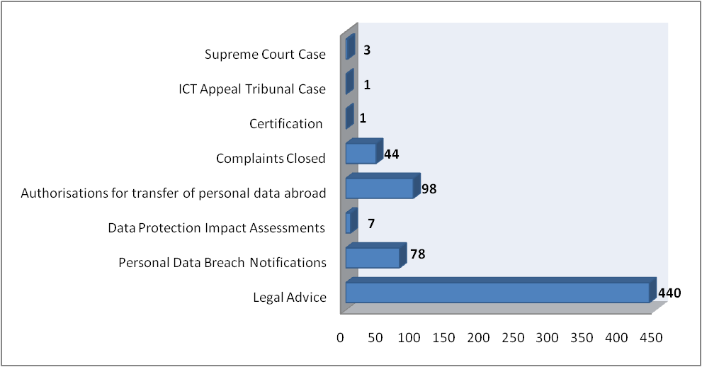
Enforcing Data Protection Statistics 2021 – 2022

Slide 24
Statistics & Nature of Cases/Complaints
For the year 2021 to October 2022, 135 complaints have been received at the DPO. Out of the 135, 34 complaints have been resolved. 101 complaints are still ongoing which are classified as per table below:
Nature of Complaint | Total
CCTV Cameras | 125
Fingerprints | 1
Unlawful Disclosure of Personal Data | 8
Rights of Data Subject Access | 1

Slide 25
THE FUTURE
A call for Global Privacy Standards
Source: https://www.videezy.com/

Slide 26
Artificial Intelligence
Source: istock photo

Slide 27
ROBOTICS
Source: www.blog.adva.com/

Slide 28
PEOPLE AND PERSONAL DATA PROTECTION
Source: https://www.dotmagazine.online/

Slide 29
SETTING
THE RIGHT EQUILIBRIUM
Source: https://wallpapercave.com/

Slide 30
COOPERATION
Source: https://www.globalmydomtrack.com/

Slide 31
Thank You
For
Your Attention…
Source: https://www.videezy.com/

