Slide 1
Training at Mauritius Institute of Training and Development
Overview on Data Protection
Presented By Mrs Dodah Pravina
Mr Bhugowon Hemrajsingh
Date : 04 October 2013

Slide 2
Agenda
Data Protection Act
Some useful definitions
Data Protection Principles
Threats to Data Privacy
Data Security
Security Policies
Questions & Answers

Slide 3
Data Protection Act
AN ACT
To provide for the protection of the privacy rights of individuals in view of the developments in the techniques used to capture, transmit, manipulate, record or store data relating to individuals

Slide 4
Definitions
Data
means information in a form which –
(i) is capable of being processed by means of equipment operating automatically in response to instructions given for that purpose; and
(ii) is recorded with the intent of it being processed by such equipment; or
b) is recorded as part of a relevant filing system or intended to be part of a relevant filing system;

Slide 5
Definitions - ctd
Personal data means –
(a) data which relate to an individual who can be identified from those data; or
(b) data or other information, including an opinion forming part of a database, whether or not recorded in a material form, about an individual whose identity is apparent or can reasonably be ascertained from the data, information or opinion;

Slide 6
Definitions – ctd
Processing means any operation or set of operations which is performed on the data wholly or partly by automatic means, or otherwise than by automatic means, and includes -
collecting, organising or altering the data;
retrieving, consulting, using, storing or adapting the data;
disclosing the data by transmitting, disseminating or otherwise making it available; or
aligning, combining, blocking, erasing or destroying the data;

Slide 7
Definitions - ctd
Sensitive personal data means personal information concerning a data subject and consisting of information as to –
the racial or ethnic origin;
political opinion or adherence;
religious belief or other belief of a similar nature;
membership to a trade union;
physical or mental health;
sexual preferences or practices;
the commission or alleged commission of an offence; or
any proceedings for an offence committed or alleged to have been committed by him, the disposal of such proceedings or the sentence of any court in such proceedings.

Slide 8
Data Protection Principles
First Principle
Personal data shall be processed fairly and lawfully

Slide 9
Data Protection Principles
Practical steps
Where you use application forms or standard documentation, you should explain your purposes/uses etc. on such forms or documentation.
Where people mostly call to your premises, you might consider displaying a notice with such explanations in your reception area for their information.

Slide 10
Data Protection Principles
Second Principle
Personal data shall be obtained only for any specified and lawful purpose, and shall not be further processed in any manner incompatible with that purpose.

Slide 11
Data Protection Principles
Practical steps
Prepare a statement of the purpose or purposes for which you hold information about others. Any individual has the right to ask you to state the purposes for which you keep such information.

Slide 12
Data Protection Principles
Third Principle
Personal data shall be adequate, relevant and not excessive in relation to the purpose for which they are processed

Slide 13
Data Protection Principles
Practical steps
Decide on specific criteria by which to decide what is adequate, relevant, and not excessive.
Apply those criteria to each information item and the purposes for which it is held.

Slide 14
Data Protection Principles
Fourth Principle
Personal data shall be accurate and, where necessary, kept up to date

Slide 15
Data Protection Principles
Practical steps
Assign specific responsibility for data accuracy under the Data Protection Act and arrange periodic review and audit.

Slide 16
Data Protection Principles
Fifth Principle
Personal data processed for any purpose shall not be kept longer than is necessary for that purpose or those purposes

Slide 17
Data Protection Principles
Practical steps
Assign specific responsibility to someone for ensuring that files are regularly purged and that personal information is not retained any longer than necessary.

Slide 18
Data Protection Principles
Sixth Principle
Personal data shall be processed in accordance with the rights of the data subjects under this Act

Slide 19
Data Protection Principles
Under section 41 of the Data Protection Act, on making a written request to a data controller, any individual about whom a data controller keeps personal information on computer or in a relevant filing system is entitled to:
a copy of the data upon payment of the prescribed fee (Rs 75),
whether the data kept by him include personal data relating to the data subject,
a description of the purposes for which it is held; and

Slide 20
Data Protection Principles
Seventh Principle
Appropriate security and organisational measures shall be taken against unauthorised or unlawful processing of personal data and against accidental loss or destruction of, or damage to, personal data

Slide 21
Data Protection Principles
Practical steps
Compile a checklist of security measures for your own systems.
In addition, where an agent is being retained to process personal data, there should be a sound contractual basis for this, with appropriate security safeguards in place.

Slide 22
Data Protection Principles
Eighth Principle
Personal data shall not be transferred to another country, unless that country ensures an adequate level of protection for the rights of data subjects in relation to the processing of personal data

Slide 23
Data Security

Slide 24
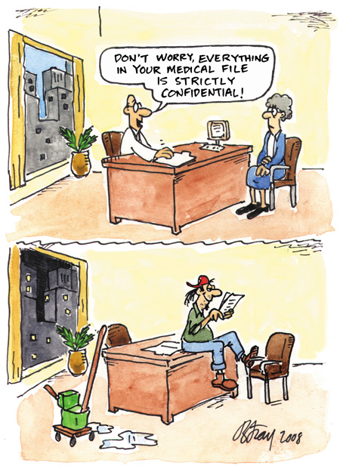
Risk
Image Source: Office of Privacy Commissioner (OPC)

Slide 25
Threats to Data Privacy
Identity Theft
Data Breach

Slide 26
Identity Theft
Identity theft occurs when someone uses your personally identifying information, like your name, Social Security number, or credit card number, without your permission, to commit fraud or other crimes.

Slide 27
Data Breach
A data breach is an incident in which sensitive, protected or confidential data has potentially been viewed, stolen or used by an individual unauthorized to do so. Data breaches may involve personal health information (PHI), personally identifiable information (PII), trade secrets or intellectual property.

Slide 28
Organisational or enterprise data contains proprietary information
Personally Identifiable Data
Employee HR Data
Financial Data
The security and confidentiality of this data is of critical importance.

Slide 29
Data Security
There are four key issues in the security of personal data associated with almost all security systems
Availability
Authenticity
Integrity
Confidentiality

Slide 30
Availability
Data needs to be available at all necessary times
Data needs to be available to only the appropriate users
Need to be able to track who has access to and who has accessed what data

Slide 31
Authenticity
Need to ensure that the data has been edited by an authorized source
Need to confirm that users accessing the system are who they say they are
Need to verify that all report requests are from authorized users
Need to verify that any outbound data is going to the expected receiver

Slide 32
Integrity
Need to verify that all input data is accurate and verifiable
Need to ensure that data is following the correct work flow rules for your institution/corporation
Need to be able to report on all data changes and who authored them to ensure compliance with corporate rules and privacy laws.

Slide 33
Confidentiality
Need to ensure that confidential data is only available to correct people
Need to ensure that entire system is secured from external and internal breaches
Need to provide for reporting on who has accessed what data and what they have done with it
Mission critical and Legal sensitive data must be highly security at the potential risk of lost business and litigation

Slide 34
Data Security - Key Principles
Collection of personal information
Source of personal information
Accuracy of personal information to be checked before use
Limits on use of personal information
Limits on disclosure of personal information
Condition for use or disclosure of personal information
Storage and security of personal information
Retention and disposal of personal information
Correction of personal information
(public authority)
Data Controller to ensure compliance
Sensitive Personal Information
Limitations and Exceptions

Slide 35
IT Security Approach
Planning
Develop well-thought-out comprehensive IT security plan, risk assessment and IT security implementation strategy which is standards-based, flexible, mission-driven, adaptable, simple and measurable
Implementation
Implement IT security plan and make it intrinsic part of day-to-day operations of the campus
Auditing
Periodically examine, assess and analyze security of central and local applications, networks, and data
Policies and Procedures
Develop policies and procedures for data backup, authentication and authorization, physical security, employee responsibilities, disaster recovery, formal incident-response procedures, etc.

Slide 36
Security Policy
The security policy is the key document in effective security practices.
Once it has been defined it must be implemented and modified and include any exceptions that may need to be in place for business continuity.
All users need to be trained on these best practices with continuing education at regular intervals.

Slide 37
Employee or End User Education
All relevant security polices must be clearly explained to the end users.
A clear explanation of the consequences for violating these polices must also be explained.
The end user needs to sign a document acknowledging that they understand the policies and consequences for violating these policies.

Slide 38
Standards
Data Security is subject to several types of audit standards and verification.
E.g ISO 27001/27002 : ISMS
Security Administrators are responsible for creating and enforcing a policy that forms to the standards that apply to their organizations business.

Slide 39
Data Classification
Data needs to be classified in the security policy according to its sensitivity.
Once this has taken place, the most sensitive data has extra measures in place to safeguard and ensure its integrity and availability.
All access to this sensitive data must be logged.
Secure data is usually isolated from other stored data.

Slide 40
Physical / Technical Controls
Controlling physical access to the data center or area where the data is stored.
Active or Open Directory is a centralized authentication management system that is available to companies to control and log access to any data on the system.
Encryption of the sensitive data is critical before transmission across public networks.

Slide 41
System and Network Security
The use of firewalls on all publicly facing WAN connections.
Deploying VLANs’ and ACLs’ to isolate sensitive departments from the rest of the network.
Shutting down unused switch ports.
If wireless is deployed, use authentication servers to verify and log the identity of those logging on.
Anti-Virus and malicious software protection on all systems.

Slide 42
IT Audit Tools
Walk around and look for passwords in the open.
Event Viewer / Log Files
Intrusion Detection/ Protection systems (IDS/IPS) such as SNORT.
These will alert Administrators of suspicious data flows.

Slide 43
References
http://www.citi.umass.edu
http://www.comberton.cambs.sch.uk

Slide 44
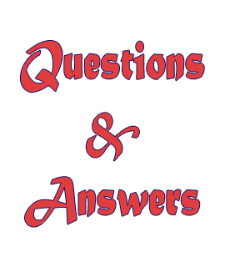
Thank you

