Slide 1
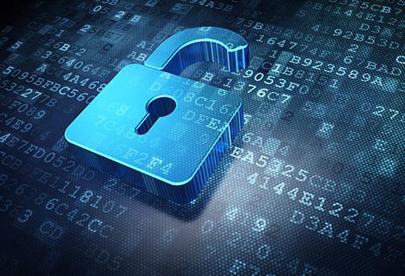
Training on Data Protection Roles of the Data Protection Office
Presented by DOOKEE Padaruth
Data Protection officer/Senior Data Protection officer (Mauritius)
Email : pdookee@govmu.org
Tel : +230 2122225
Helpdesk : +230 203 9076
Website : http://dataprotection.govmu.org
Date: 18th December 2014

Slide 2
Contents
Registration/Renewal
Data Protection Compliance
Overall Administration of DPO
Audit
Security

Slide 3
Registration/Renewal
Assist DC in filling application form
Verify all necessary documents submitted
Ensure that all required personal infortion are declared on application form

Slide 4
Data Protection Compliance
Provide assistance and advice to DCs on the issues of DPA compliance
Attends meeting with the DCs on data protection issues
Issue enforcement Notices
Carry out Security check & audit
Role of DPO From enforcer to strategic advisor
The role of the regulators towards compliance monitors, educators, liaisons between business and government, and active participants in privacy debates

Slide 5
Data Protection Compliance
Provide assistance/advice to organisations
Attends meeting with the DC on data protection issues
Issue enforcement Notices
Carry out Security check & audit

Slide 6
Overall Administration of DPO
Keep in touch with
Research &
Technology
Process files for certificates.
Attend queries of the Data Controllers
Providing adequate training to staff and Data Controllers regularly
Sensitization
Investigation to complaint

Slide 7
Research
- Keep in touch with research & emerging Technologies
Produce guidelines to help DCs.
Project Management & Data Protection
Data Security & IT
Setting up of a forensic Lab

Slide 8
Technology
Technology opens the doors to a world of opportunities.
But there are serious privacy risks considerations.
Technology developers will need to enshrine privacy in the standards development process using privacy by design approach

Slide 9
Auditing
1. Purpose
to obtain a complete picture, as far as possible,
of the structure of personal information flows within an organisation so that the appropriate compliance procedures can be put in place to ensure that the organization deals with personal data in accordance with
data protection law,
the general law and
best practices.

Slide 10
Auditing
2. Organisation Chart
For large-scale and complex organisations the first stage is to obtain an organizational chart showing
the operational,
managerial and
departmental structure of the organization together with
the names and locations of the personnel who have managerial or
operational responsibility for information within the organisation.

Slide 11
Auditing
3. Questionnaires
Data protection audit questionnaires should then be sent to each named individual
for completion or
may be used as the basis for face to face interviews.

Slide 12
Auditing
4. Analysis of information
Once all the questionnaires have been completed the organisation is in a position
to compile a complete diagram of the use of information within the organization which can then form the basis of a review of the organisation's compliance with
data protection law and other relevant law.
For large-scale and complex organizations,
it is recommended that such audits are carried out annually.

Slide 13
Security
Security as a core business value
A data controller shall –
(a) take appropriate security and organisational measures for the prevention of unauthorised access to, alteration of, disclosure of, accidental loss, and destruction of the data in his control; and
(b) ensure that the measures provide a level of security appropriate to –
(i) the harm that might result from the unauthorised access to, alteration of, disclosure of, destruction of the data and its accidental loss; and
(ii) the nature of the data concerned.

Slide 14
Other related issues
Publications & ICT Laws
ICTA News Releases
Public Notices
Tender Notices
Events
Publications & Reports
Guidelines & Decisions
Public Consultations
ICT Laws
Telecommunication Directives
Memorandum of Understanding (MOU)
Regulations
Regulations on ICT Appeal Tribunal

Slide 15
Conclusion
As the digital ecosystem evolves, regulators and organisations need to open the lines of communication.
Together, regulators and organisations need to serve as the stewards of privacy protection

