Slide 1
Big Data Framework: Data Privacy & Data Protection Guidelines for Development and Humanitarian Sector

Slide 2
INTRODUCTION
For the past years, the potential of big data derived from the Internet and other digital devices to transform targeted advertising, recommender systems, location based services, logistics and other activities in the private sector has come to fruition.
Increasingly, parallel applications in development work have emerged, proving the utility of big data for monitoring and measuring social phenomenon including disease outbreaks, food security, or migration. However, the opportunities presented by big data simultaneously raise serious concerns about privacy, especially when it comes to use of personal data.

Slide 3
INTRODUCTION
To realise the benefits of “Big Data for Development” it is important to find solutions for how to protect fundamental rights and values, including the right to privacy as recognized by the Data Protection Authorities.
Data Protection and Privacy is to strengthen the overall understanding of how privacy protected analysis of big data along with the assessment of risks and benefits can contribute to sustainable development and humanitarian action.
.

Slide 4
INTRODUCTION
Big data is the term for a collection of data sets so large and complex that it becomes difficult to process using on-hand database management tools or traditional data processing applications.
The challenges that we face with dbms (database management system) tools and other technologies are capture, curation, storage, search, sharing, transfer, analysis, and visualization.

Slide 5
Big Data
Big data is a catch-all phrase describing data collections which merge data from multiple sources into a single one, so large that it cannot be processed using standard techniques.

Slide 6
Why Big data?
Key enablers for the appearance and growth of ‘Big-Data’ are:
Increase in storage capabilities
Increase in processing power
Availability of data

Slide 7
Big Data EveryWhere!
Lots of data is being collected and warehoused
Web data, e-commerce
purchases at department/ grocery stores
Bank/Credit Card transactions
Social Network

Slide 8
How much data?
Google processes 20 petabytes (PB) a day (2008)
Wayback Machine has 3 PB + 100 terabytes (TB)/month (3/2009)
Facebook has 2.5 PB of user data + 15 TB/day (4/2009)
eBay has 6.5 PB of user data + 50 TB/day (5/2009)
CERN’s Large Hydron Collider (LHC) generates 15 petabytes a year

Slide 9
Type of data
Relational Data (Tables/Transaction/Legacy Data)
Text Data (Web)
Semi-structured Data (XML)
Graph Data
Social Network, Semantic Web (RDF), …
Streaming Data
You can only scan the data once

Slide 10
Big Data: 4V’s

Slide 11
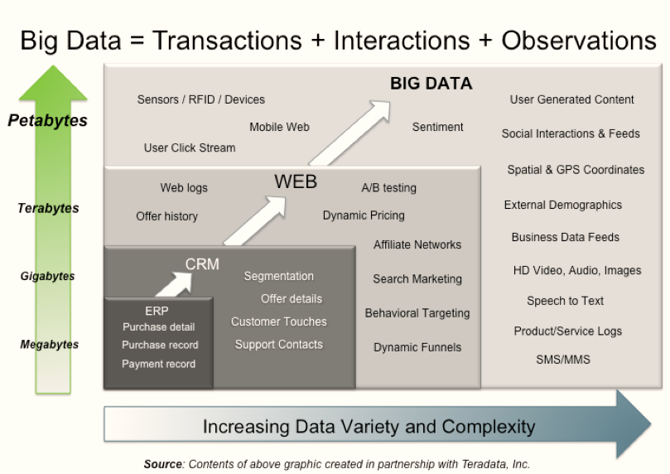

Slide 12
Examples:

Slide 13
What to do with these data?
Aggregation and Statistics
Data warehouse and OLAP
Indexing, Searching, and Querying
Keyword based search
Pattern matching (XML/RDF)
Knowledge discovery
Data Mining
Statistical Modeling

Slide 14
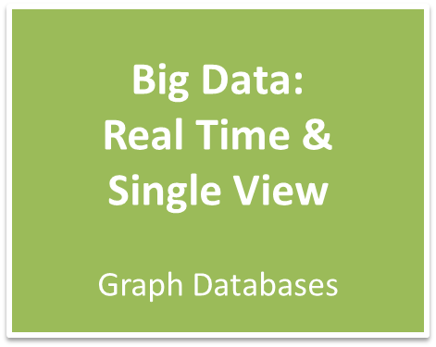
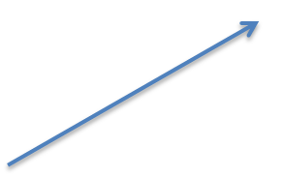
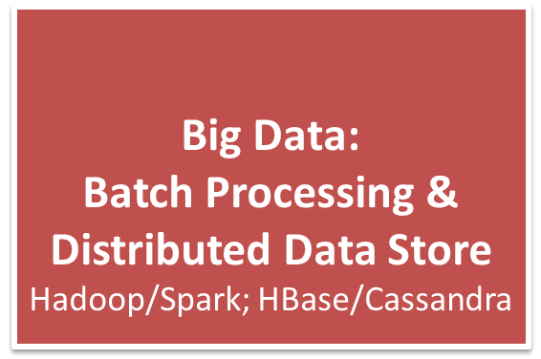
The Evolution of Business Intelligence
scale
scale
1990’s
2000’s
2010’s
https://www.google.de/search?q=evolution+of+business+intelligence&newwindow=1&tbm=isch&tbo=u&source=univ&sa=X&ei=gEGoU5KXBuTb4QSGsoH4BQ&ved=0CDsQsAQ&biw=1366&bih=64

Slide 15
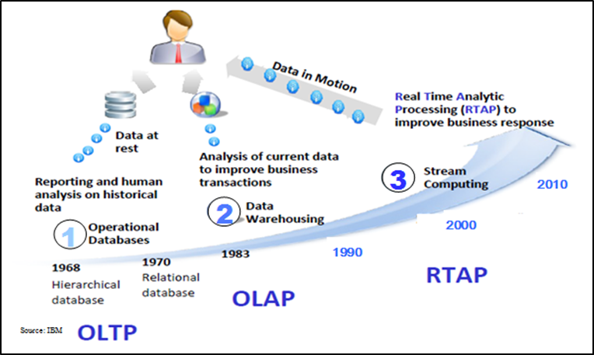
OLTP: Online Transaction Processing (DBMSs)
OLAP: Online Analytical Processing (Data Warehousing)
RTAP: Real-Time Analytics Processing (Big Data Architecture & technology

Slide 16
Data Protection Standpoint
Taking a strict position on privacy could arguably lead to restraining potential developments in science, which derives valuable insights from big data. Therefore calls have been made for a different approach, that of data empowerment –vesting individuals with the power to use their data in ways they wish - which could still be reconciled with the general public’s interest in processing the data concerned.

Slide 17
Applied Privacy Principles
Purpose specification and limitation: data are to be collected for specified, explicit and legitimate purposes and cannot be further processed in a way incompatible with these. However, in general, further processing for historical, statistical or scientific purposes should not be considered incompatible with the initial purpose.
Transparency and concern: individuals are to be informed about the processing of their data, which requires explicit consent that can be withdrawn anytime.
Data minimisation: data must be accurate, relevant and not excessive in relation to the purposes for which they are processed.
Limited retention: keeping data in a form which permits identification of a person only as long as it is necessary for the purposes for which the data were collected or for which they are further processed.

Slide 18
Data Protection Measures
Individual control over what personal data companies collect from them and how they use it.
Transparency, or easily understandable and accessible information about privacy and security practices.
The collection, use, and disclosure of personal data to be done in ways that are consistent with the context in which consumers provide the data.
Security and responsible handling of personal data.
Access to their personal data in usable formats, with the power to correct errors.
Reasonable limits on the personal data that companies collect and retain.

Slide 19
Importance of Big Data
Increase innovation and development of next generation product
Improve customer satisfaction
Sharpen competitive advantages
Create more narrow segmentation of customers
Reduce downtime

Slide 20
Advantages of Big Data
Dialogue with customers
Just a small example: when any customer enters a bank, Big Data tools allow the clerk to check his/her profile in real-time and learn which relevant products or services (s)he might advise. Big Data will also have a key role to play in uniting the digital and physical shopping spheres: a retailer could suggest an offer on a mobile carrier, on the basis of a consumer indicating a certain need in the social media.

Slide 21
Advantages of Big Data
Re-develop your products
Perform risk analysis
Keep your data safe
Create new revenue stream
Customise your website in real time
Reduce maintenance cost
Offer tailored health care
Offer enterprise wide insights
Make skater cities

Slide 22
Disadvantages of Big Data
A comprehensive approach to using big data.
Most companies collect gobs of data but they don’t have comprehensive approaches for centralizing the information. According to a recent survey by LogLogic, 59% of the more than 200 security officers who responded say they are either using disparate systems for gathering data, not managing log data, or they use antiquated spreadsheets. The right analytics tools can definitely help to streamline and make sense of all this data, but a well-conceived strategy for collating data sources from different silos is still necessary.

Slide 23
Disadvantages of Big Data
Getting the right information into the hands of decision makers.
Companies should use analytics “to avoid getting buried under the humongous amount of information they generate through various outlets,” according to a recent ZDNet Asia interview with XMG analyst Jacky Garrido. It’s true – too many companies lack coherent approaches to utilizing the gushers of customer and business data that are flowing into their organizations. As Garrido notes, as data is gathered, it needs to be mapped out. Moreover, critical data needs to be separated from insignificant or unnecessary data (e.g. inconsequential comments made by customers on Facebook or Twitter).

Slide 24
Disadvantages of Big Data
Effective ways of turning “big data” into “big insights.”
No matter how you slice it, data is just that – data. In and of itself, data doesn’t necessarily provide decision makers with the kind of insights they need to do their jobs effectively or to take the best next action based on discoveries about customer trends or other revelations about market conditions. This is where the right analytics tools are needed to help data scientists and business leaders make sense of the volumes of data that are pouring into their organizations. This includes the use of data visualization tools that can be used to help put data into context.

Slide 25
Disadvantages of Big Data
Big data skills are in short supply.
There’s already a shortage of data scientists in the market. This includes a scarcity of people who know how to work well with large volumes of data and big data sets. Companies need the right mix of people to help make sense of the data streams that are coming into their organizations. This includes skills for applying predictive analytics to big data, a skill set that even most data scientists lack.

Slide 26
Conclusion
The Age of Big Data is here, and these are truly revolutionary times if both business and technology professionals continue to work together and deliver on the promise.

Slide 27
References
https://www.intgovforum.org
http://www.slideshare.net
http://wwwiti.cs.uni-magdeburg.de
http://www.cs.kent.edu
http://spotfire.tibco.com/
http://datascienceseries.com

