Slide 1
Key note Adddress
By The Data Protection Commissioner
Data Protection Office

Slide 2
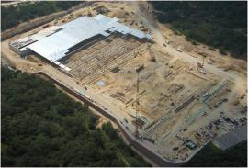
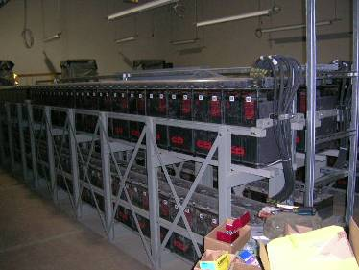
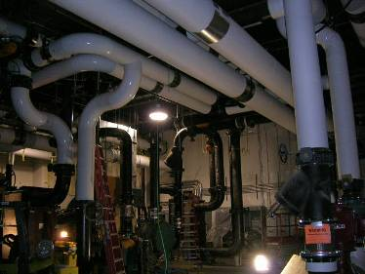
CLOUD COMPUTING
Data Centers around the World

Slide 3
Data Protection and Security using Disruptive Technologies
The (Data )Controller is Always Responsible
And
Accountable

Slide 4
Data Protection Act in a nutshell
Notice
Purpose
Consent
Security
Disclosure
Access
Accountability
DPA

Slide 5
General Data Protection Regulations :GDPR
Awareness
Information you hold
Communicating privacy information
Individuals’ rights
Subject access requests
Lawful basis for processing personal data
Consent
Children
Data breaches
Data Protection by Design
Data Protection Impact Assessments
International Data Transfers

Slide 6
What Organisations Have to do
Proactive
The system must be proactive, not reactive. It must prevent privacy incidents before they happen.
Default
Automatic protection in IT systems or processes at all stages.
Embedded
Privacy must be an essential component of functionality.
Full functionality
Protection must be planned in a complete way, with no compromise to either business or security.
End-to-end security
Full lifecycle privacy protection must be embedded into the system from the first step of data processing.

Slide 7
WAY FORWARD
GET READY
Thank you.

