Slide 1
Data Protection & Privacy: What’s Next ?
Clarel Constance
Jan 2020

Slide 2
Current Situation
Our personal data trace
Regulators and IT Systems
The reality or myth of consent
The economics of data re-identification

Slide 3
Our personal data trace (what we leave behind)
Personal data trace: URLs, time stamps, IP addresses, cookies IDs, browser information and much more, from our devices
Example: an Ad-tech company ( Quantcast ) has amassed over 5300 rows and more than 46 columns worth of data for 1 person for 1 week
(source Privacy International)
Fitness trackers, GPS
Assistance (e.g Hello google)
Face recognition

Slide 4
Regulators & IT Systems
Diversity of regulations
EU, US, China, UK, India, Switzerland….
Complexity and cost of compliance
Example of “forgetting a customer” from an IT perspective
Financial Times article on GDPR (June 2019)
74% European companies consider that data protection requirement is the number one obstacle for developing new tech (up from 45% in 2017)

Slide 5
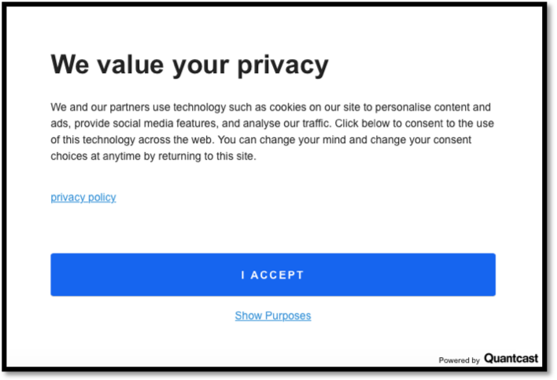
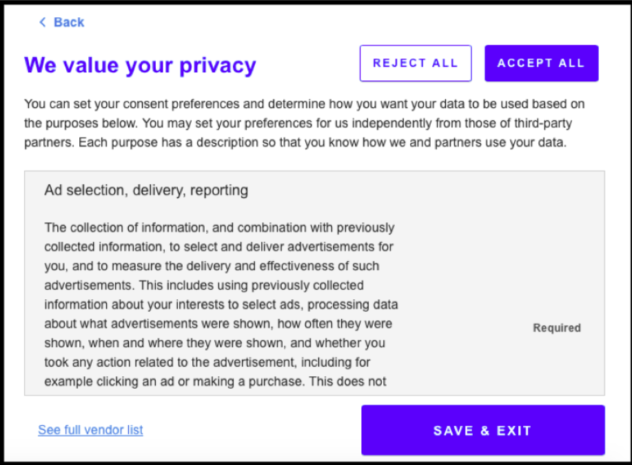
Reality or Myth of Consent
“NO Consent” is designed to be a hassle
What is “Informed consent”
“Consent” because no other choice.

Slide 6
The economics data re-identification
Definition of Data Re-id: Matching personally identifiable information, Pii, with anonymized data
Also known as de-anonymization since years 2000 US
Anonymous Data required to feed AI systems for teaching
Definition of the Data Broker: Buy data (personal or anonymized), collect data and sell their insights
Cambridge Analytica, said that its foundational data set for clandestine U.S. voter targeting efforts had been licensed from well-known data brokers such as Acxiom, Experian and Infogroup. Specifically it claimed to have legally obtained.
Example: the data broker Acxiom’s annual report

Slide 7
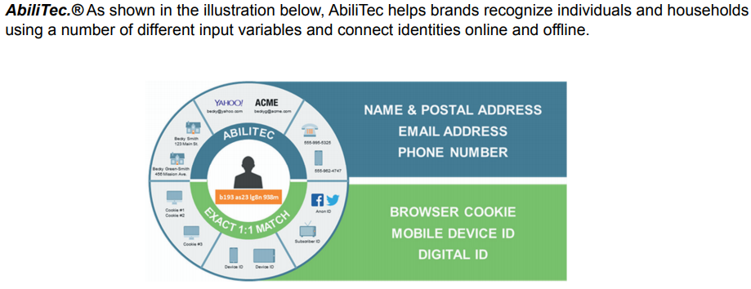
Example: re-Id offering

Slide 8
The Future
How future technology disruption will affect Data Protection
Monetizing our Pii

Slide 9
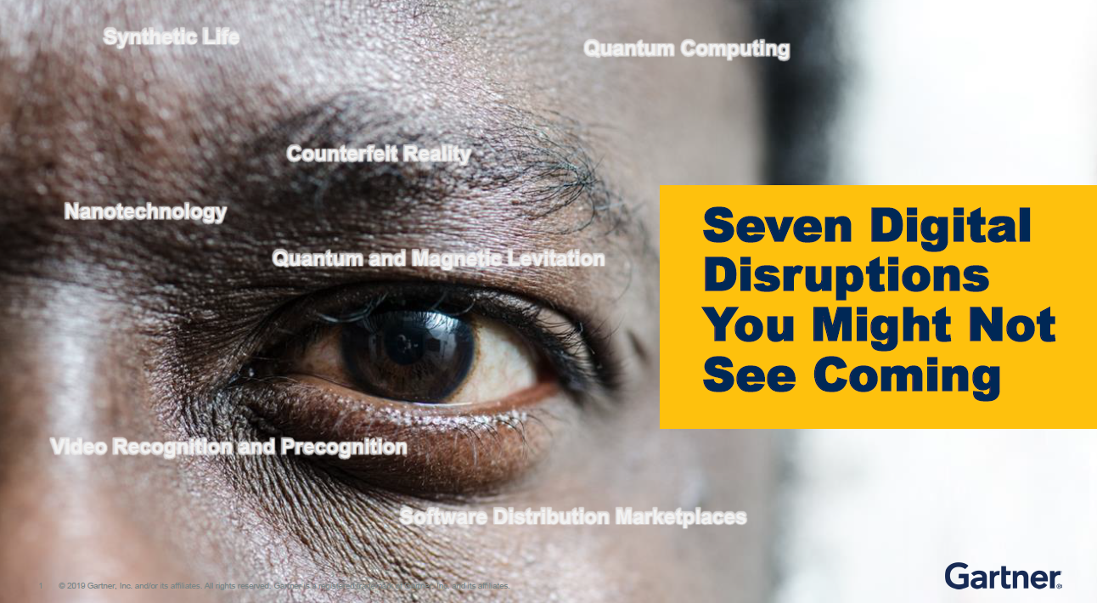
From Gartner IT Symposium Sept 2019

Slide 10
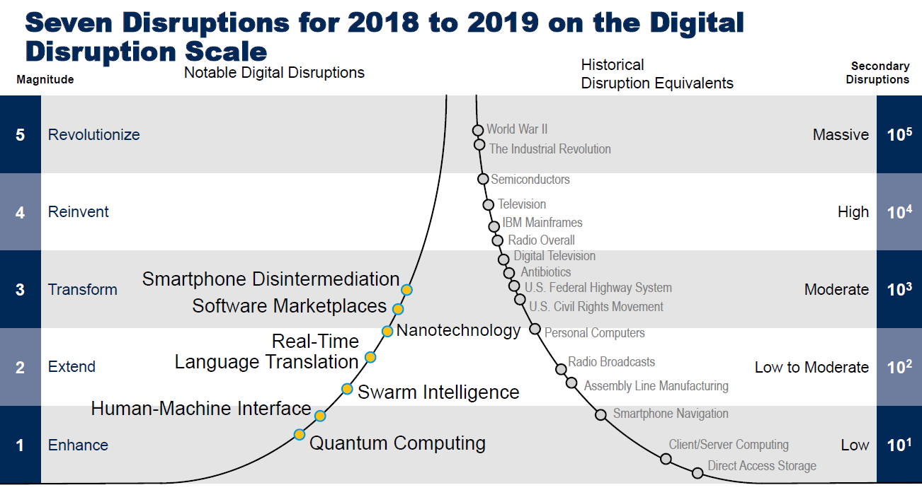

Slide 11
Which ones will affect Data protection and Privacy for sure ?
Quantum Computing
Available computing power
Re-identification in a matter of seconds
Breaking of data encryption (decryption)
Swarm Intelligence
Network of AI systems
Very quick Re-identification
Increase probability of successful attacks
Realtime Language translation
Lowering the “consent” barrier
Smartphone Disintermediation
Devices that connect to Internet applications directly
Need to redefine consent

Slide 12
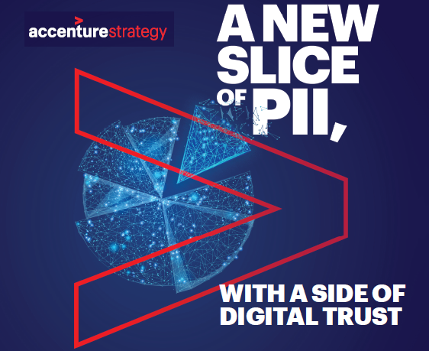

Slide 13
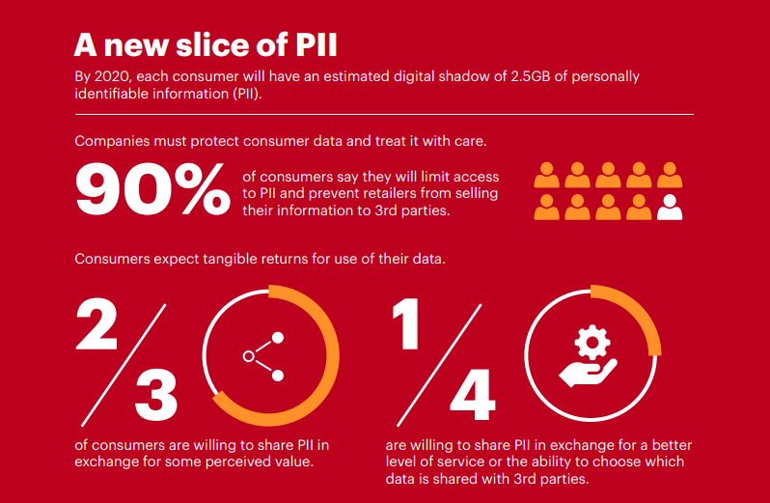

Slide 14
Monetizing PII
THE OPPORTUNITY IS SIGNIFICANT. The World Economic Forum predicts that the global data market will generate more than half a trillion dollars by 2024. Companies can reduce costs, improve customer experience and monetize data, with the right approach.
DIGITAL TRUST IS ESSENTIAL. Regulations giving consumers “back” their data are ramping up. Individuals decide who can access it, which has severe competitive consequences. Eighty-two percent of companies say a lack of data security and ethical controls could exclude them from essential digital platforms.
VALUE IS INHERENT IN DIGITAL TRUST. Customers expect a tangible return from the use of their data in the form of an enhanced customer experience. If they receive this, value drives digital trust—and in return, digital trust drives value.
(source: Accenture )

Slide 15
Thank You

