Slide 1


By Hans ANSAH
Head Boy - Ebene State Secondary School Boys

Slide 2

BONZOOURRR ZOT TOUU

Slide 3




What is DATA PROTECTION?
Safeguarding Sensitive Information.
By Hans ANSAH
Head Boy - Ebene State Secondary School Boys

Slide 4


List of contents
  Introduction
  The Importance of Data Protection
  Protection Methods
  Best Practices for Data Protection
  Response to Incidents
  Conclusion

Slide 5
Introduction
Data protection ensures the safety and availability of sensitive information.

Slide 6
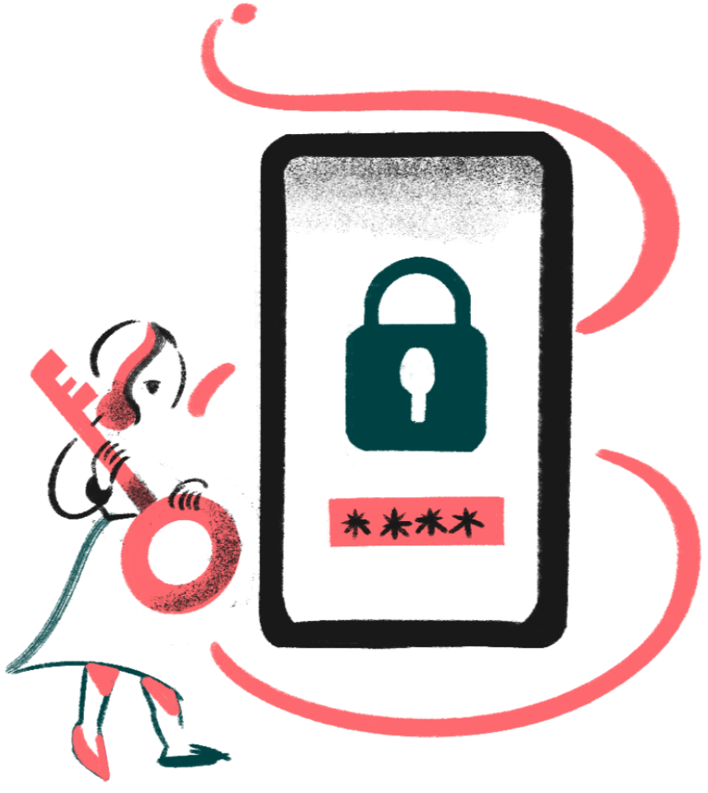

The Importance
of Data Protection
  Data protection is a fundamental right protected by laws like DPA 2017, & GDPR.
  Crucial for building trust, enhancing brand reputation, preventing fraud and cybercrimes.
  Saving time and resources.

Slide 7
DID YOU KNOW..
  Mauritius established the Office of the Data Protection Commissioner, making it operational and ensuring compliance with data privacy standards. Mauritius was the first African country to do so.

Slide 8





Protection Methods
:
Some key methods to protect against cyber threats include:
Antivirus
Multi factor Authentication
Encryption
Detects and removes malicious software
Requires two or more forms of verification
Securing data by turning it into code

Slide 9

Best Practices
for Data protection
To improve cybersecurity, follow these best practices:
  Conduct a comprehensive data inventory to understand your organization's data types, storage locations, and access rights.
  Data security involves safeguarding digital information from unauthorized access, corruption, or theft through encryption, access controls, and regular risk assessments throughout its lifecycle.

Slide 10


  Identify and isolate threats
  Communication with security teams and stakeholders
Response to Incidents
  Data recovery from backup
  Evaluate and improve security policies

Slide 11




Slide 12

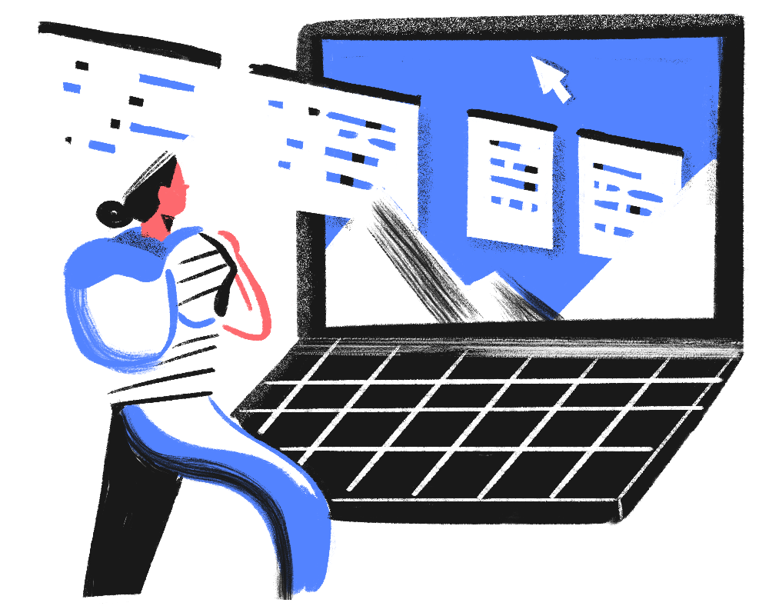
Conclusion
Data Protection is a crucial element in protecting your digital assets. By understanding existing threats and implementing appropriate security measures, you can reduce risks and protect critical information.

Slide 13
and let's improve cyber security together

Slide 14

Thank you for your attention

