Slide 1
“DATA PROTECTION FOR THE YOUTH”
Presented by:
Me Sivaramen Subbarayan
LL.B(Hons), LLM, Barrister-at-Law
Legal Affairs Director
Legal Affairs Office
University of MauritiuS
18 July 2024

Slide 2
Data Privacy as part of the Curricula? How is this being implemented at Tertiary Level?

Slide 3
UoM has its own policy in place and training for members of staff. UoM has a Data Protection Policy and an IT policy which are available and applicable to all members of university.

Slide 4
WHAT IS DATA PRIVACY?
Maintain control over personal information/data
Decide how personal information/data is collected, used and shared
Ensure personal information/data is not exploited and misused

Slide 5
WHAT IS PERSONAL DATA?
Personal data” means any information relating to a data subject; For example: Students name, Date of Birth, contact number, home address etc…

Slide 6
WHAT IS DATA SUBJECT?
It means an identified or identifiable individual, in particular by reference to an identifier such as a name, an identification number, location data, an online identifier or to one or more factors specific to the physical, physiological, genetic, mental, economic, cultural or social identity of that individual;

Slide 7
WHO IS A DATA PROCESSOR?
A person who, or public body which, processes personal data on behalf of a controller.

Slide 8
DATA CONTROLLER
UoM is registered as a Data Controller with Data Protection Commissioner’s Office, as per the Act.
This allows the UoM to control data associated with its academic and research activities, administrative functions and processes library services and any other business services.

Slide 9
UoM is a tertiary institution which provide education responsive to the social administrative scientific, agricultural and technological needs of Mauritius as per Section 4 of the UoM Act 1971 (as amended).
This presentation will be focusing on how Data Privacy as part of the curriculum is being implemented at UoM as opposed to looking into how UoM itself deals with Data Privacy as a processor and controller.

Slide 10
Students at UoM are made aware of their rights and the Data Protection Act 2017 when they are enrolling at the University where the University highlight to them how their data are going to be handled and made them aware of the Data Protection Policy and IT Policy which deal with handling, using, processing personal and confidential data at the university.

Slide 11
The University of Mauritius (UoM) has incorporated Data privacy within different modules which are taught at the University.

Slide 12
Aims and objectives of implementing Data Privacy as part of the curriculum
Understand the principles behind the tools and techniques used to secure data
Create technical solutions to real-world security problems
Build the learner’s knowledge of network and application in cyber security
Understand digital crimes and cyber incident at a law enforcement level
To ensure compliance with data protection standards and regulations
To safeguard and secure every piece of data that the University handles and processes
To build the learner’s knowledge of network and application in cyber security

Slide 13
UoM operates under different faculties
Faculty of Agriculture
Faculty of Engineering
Faculty of Information ,Communication and Digital Techonologies
Faculty of Law and Management
Faculty of Medicine and Health Sciences
Faculty of Science
Faculty of Social Sciences and Humanities

Slide 14
A summary of Data Protection on some of the University of Mauritius (UoM) programmes
Programme | Module | Topics
LLB (Hons) | Intellectual Property Law | Confidentiality of Information and Obligation of Confidence
BA (Hons) Law and Management | Intellectual Property Law | Confidentiality of Information and Obligation of Confidence
Diploma/Bsc Communication Studies | Legal Aspects of Business Communication (Communication specialisation) | The Data Protection Act 2017: the mapping of the regulations based on the EU GDPR, Obligations on controllers and processors, principles relating to the processing of personal data

Slide 15
Diploma/Bsc Communication Studies | Law relating to the Media (Journalism Specialisation) | The Data Protection Act 2017: the mapping of the regulations based on the EU GDPR, Obligations on controllers and processors, principles relating to the processing of personal data
LLM (Corporate Law) | Legal Framework of Government | Data Protection in Mauritius, Data Protection Act 2017, GDPR
BA (Hons) Law and Criminal Justice | Cyber Crimes | Data Protection

Slide 16
Msc Network Security and Management | Internet of Things Enterprise Networking Research Methodology Cryptography | Information Security Management Computer Forensics Cyber Laws
BSc (Hons) Cyber Security | Database systems and Security Introduction to computer networks Cyber Security Maths and Stats Security Fundamentals | Web Technologies and Security Cyber Laws and Regulations Human Factors in Cybersecurity Network Security Software Security Research Trends and Emerging Technologies
BSc(Hons) Cyber Security Top-Up | Data Security Network Security Software Security System Security | Societal Security Concerns Forensics and Incident Reporting Cyber laws and Standards

Slide 17
Benefits of Data Privacy Education
Data Privacy is integrated into the Education system at UoM to raise awareness of the right to privacy of the Data systems and its applications.
The Challenges and opportunities of Data privacy are being fostered through various modules at UoM for the students.
Some examples of the Topics being covered at UoM are:
Authentication: strength, Password attack, Password Storage
Malicious code and activity, Fingerprint, Face Recognition
Data Backup and Recovery, Issues of Copyrights
Cyber Crimes and Cyber Security, Computer Misuse, Fraud

Slide 18
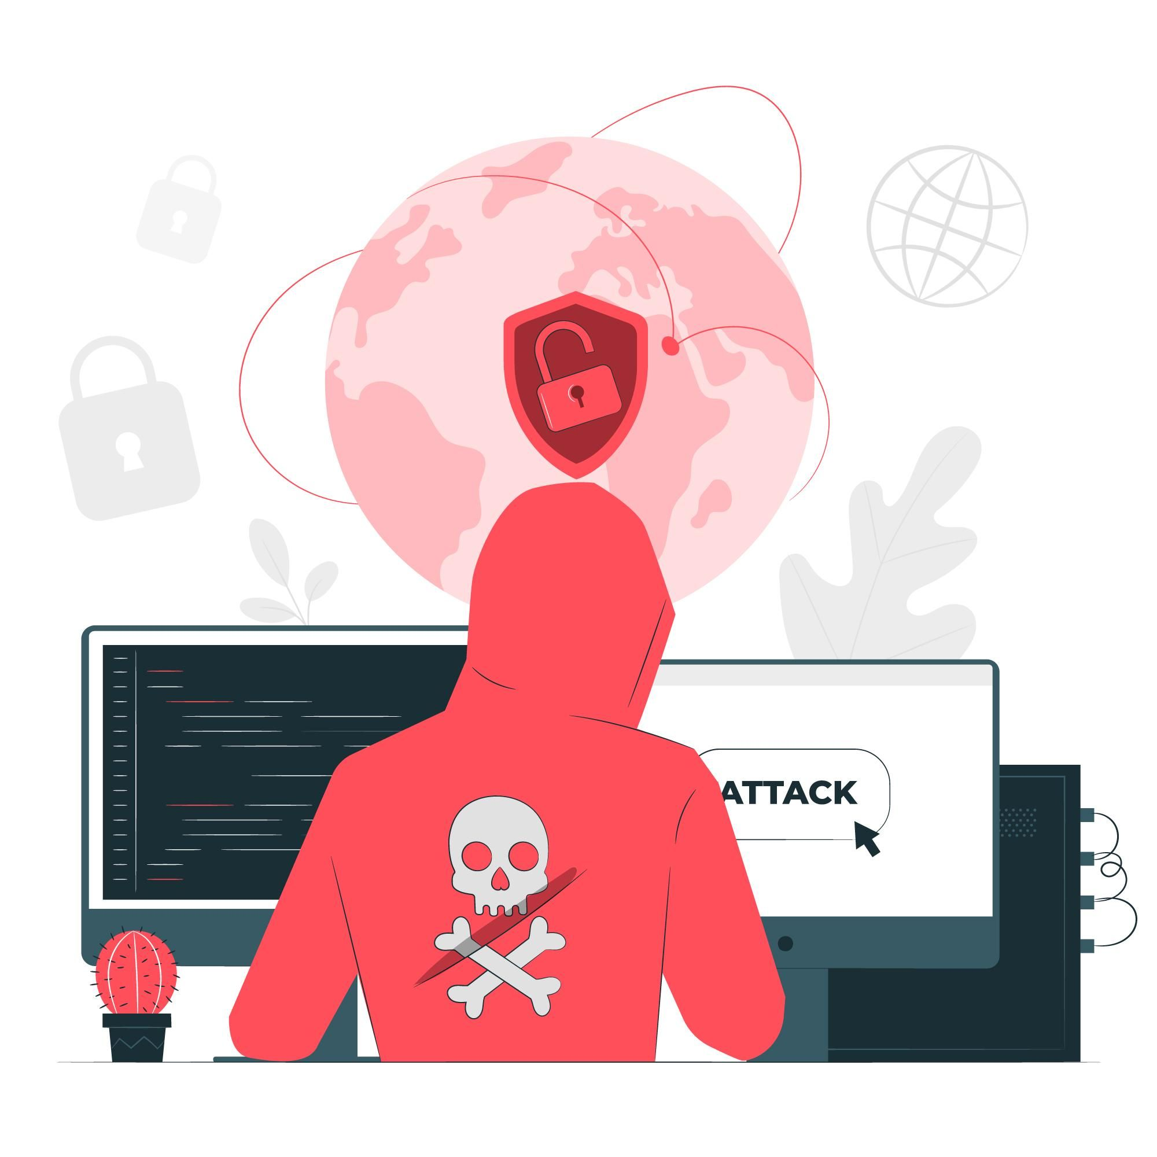
The UoM do emphasis Data Privacy is a concern for the youth
Data may be misused for examples:
(1) Illegal online activities such as identity theft,
(2) Tracking a person which may lead to crimes such as kidnapping
(3) Financial gain to steal people’s money by hacking.
(4) Circulating of fake news

Slide 19
Some of Data Privacy general training to staff and students which are in the process of being implemented are as follows:
Serious implications for not protecting your personal data online,
Some steps which will help protect your personal data and privacy online.
The consequences of not handling data appropriately
and any misuse of same.

Slide 20
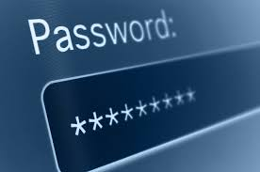
CASE STUDY (1)
USE GOOD PASSWORDS
Creating long and strong passwords for your online accounts is one of the most effective ways you can protect your personal information, and keep yourself safe from attackers. Always make sure your passwords are at least of eight (8) characters in length.
It's easy to think "I don't have anything worth stealing", or "no one's going to go to the effort to hack me". But most online security attacks are random.

Slide 21
CASE STUDY (2)
Display of Information online
There are many social websites for example: Facebook, Instagram…that allow individuals to create public profiles and add personal information like contact number, date of birth…
BEWARE!
There exists Identity thieves online that can steal your personal information displayed to impersonate oneself. Example: For blackmail purposes.

Slide 22
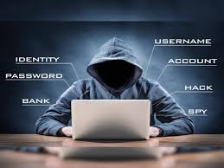
CASE STUDY (3)
Be weary of odd Emails
Individuals often receive random emails stating that: “ there is a package arrival for you” or “ you need to check your bank account” and a link will usually be sent alongside.
NEVER CLICK ON ANY LINK!
It is always best to go directly to the required website for your Bank and log in to the secured web address or rather call directly or visit your Bank as you may end up being a victim of Bank Fraud.

Slide 23
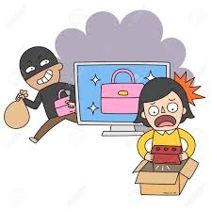
CASE STUDY (4)
ONLINE SHOPPING
Online shopping scams are a type of online scam in which cybercriminals try to portray themselves as legitimate online sellers to steal your personal information or money. Many cybercriminals will create a fake website that either looks like a genuine seller or impersonates established retailers like Amazon.
Always make sure you are on a secure website.
Example: The http:// should be read as “http:s//”. The extra “s” stands for secure. In addition, a lock or key symbol should be represented on the lower corner of the web page.

Slide 24
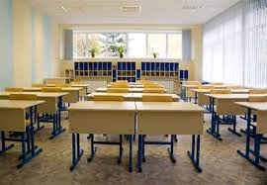
UoM is conscious of the landscape of cyber risks which is driven by advancements in technology.
Education and training can help students understand and recognize cyber threats. This includes educating students on how to identify suspicious emails, links, how to avoid falling victim to social engineering attacks and how to handle sensitive information securely.
The Academic staff has conducted seminar and workshop regarding the above for all members of the University.

Slide 25
THANK YOU!

