Slide 1
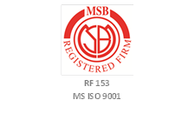
Security and Safe Keeping of official information
Presented by:
DOOKEE Padaruth (Data Protection Officer/ Senior Data Protection Officer)
Date: Monday 09 September 2016
Venue: Lecture Room 641, Level 6, Fook House. Bourbon Street, Port Louis
19 September 2016 at 13:00

Slide 2
The Main Elements
1
2
Safekeeping of Documents
3
Classification of information
Security and Safe Keeping of official information
4
Other Security issues
5
Other related laws for Security and safe Keeping of official information
Notes:
This is another option for an Overview slide.

Slide 3
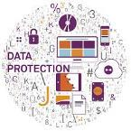
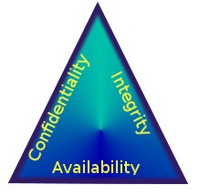
Security and Safe Keeping of official information
The aspect of Confidentiality and Security
Safekeeping of Documents

Slide 4
The aspect of Information Security
Confidentiality, integrity and availability, also known as the CIA triad,
is a model designed to guide policies for information security within an organization.
The elements of the triad are considered the three most crucial components of security.
In this context,
confidentiality is a set of rules that limits access to information,
integrity is the assurance that the information is trustworthy and accurate, and
availability is a guarantee of reliable access to the information by authorized people.

Slide 5
Confidentiality
Confidentiality is roughly equivalent to privacy.
Measures undertaken to ensure confidentiality are designed to prevent sensitive information from reaching the wrong people, while making sure that the right people can in fact get it:
Access must be restricted to only those authorized parties to view or maintain the data in question as per their designated role.
It is common, as well, for data to be categorized according to the amount and type of damage that could be done should it fall into unintended hands.
More or less stringent measures can then be implemented according to those categories.

Slide 6
Definitions (Data Protection Act)
Sensitive Personal Data
Sensitive Personal Data
Racial / Ethnic Origin
Political Opinion / Adherence
Religious / Similar Belief
Membership to Trade Union
Physical / Mental Health
Sexual Preferences / Practices
Criminal Convictions

Slide 7
Safeguarding data confidentiality
Safeguarding data confidentiality may involve
strong passwords and password-related best practices and
information about social engineering methods,
to prevent them from data-handling rules with good intentions and potentially disastrous results.
Extra measures might be taken
in the case of extremely sensitive documents,
precautions such as storing only on very secured computers,
Protected disconnected storage devices or, for highly sensitive information, in hard copy form only.

Slide 8
Integrity
Integrity involves maintaining
the consistency, accuracy, and trustworthiness of data over its entire life cycle.
Data must
not be changed in transit, and
steps must be taken to ensure that data cannot be altered by unauthorized people (for example, in a breach of confidentiality).
These measures include
file permissions and user access controls.
- Version control maybe used to prevent erroneous changes or accidental deletion by authorized users becoming a problem.
In addition, some means must be in place
to detect any changes in data that might occur as a result of non-human-caused events such as strong electromagnetic pulse (EMP) or file/ computer/server crash.

Slide 9
Availability
Availability is best ensured by
rigorously maintaining all hardware, performing hardware repairs immediately when needed and
maintaining a correctly functioning operating system environment that is free of software conflicts.
It’s also important
to keep current with all necessary system upgrades.
Safeguards against data loss or interruptions in connections must
include unpredictable events such as natural disasters and fire.
To prevent data loss from such occurrences,
a backup copy may be stored in a geographically-isolated location,
perhaps even in a fireproof, waterproof safe.
Extra security equipment
or software such as firewalls and proxy servers can guard against downtime and unreachable data due to malicious actions such as denial-of-service (DoS) attacks and network intrusions.

Slide 10
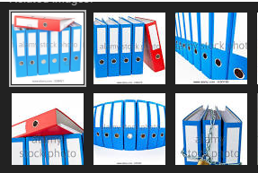
2. Safekeeping of Documents

Slide 11
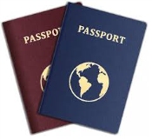
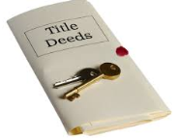
important documents
Where do you keep your most important documents?
Perhaps, you have a filing cabinet
These might include:
Passports
Titles and Deeds
Wills, Power of Attorney, Trusts
Legal documents
Birth certificates
Marriage, and other certificates
Bonds and other banking items
When you have a central location where all important papers are kept, then you know exactly where to find them when you need them.
Sounds simple. Yet, most people do not practice this easy organization tip.

Slide 12
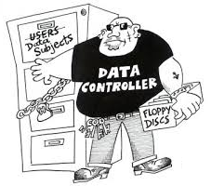
Definitions (Cont.)
Data Controller means a person who,
either alone or jointly with any other person,
makes a decision with regard to the purposes for which
and in the manner in which any
personal data are, or are to be, processed;
The data controller can be the organisation,
or can also be an individual if that individual is acting on his/her own initiative
for example, doctors, lawyers or sole traders.

Slide 13
important documents
5 Tips to Help You Always Know
- Where Your Most Important Documents Are:
1.All in One Location
2. Eliminate the Disorder
3. Digitize What You Can
4. Always Return Them
5. Keep Them Safe

Slide 14
5 Tips to Help You Always Know Where Your Most Important Documents
All in One Location
Find one location or container
to keep all of your most important documents.
It can be a drawer, filing cabinet nearby or in the Registry.
My important papers
must be in file of a unique color,
in order to identify them rapidly.
2. Eliminate the Disorder
Be very selective about
what goes in your important papers collection.
There are very few documents that truly need to be in there.
For example,
receipts and other simple documents should be in their own filing cabinet.
Think of your important papers as those that are
“Top Secret” or non-replaceable.

Slide 15
5 Tips to Help You Always Know Where Your Most Important Documents
3 Digitize What You Can
Your important papers box should
only be for documents that must be in hard copy.
For documents that don’t explicitly need to be paper,
scan them to your digital library.
4. Always Return Them
When you do need an important document,
make sure that you put it back as soon as you are done with it.
Don’t place it on other location.
Always put it immediately back in the original place.
5. Keep Them Safe
Keep your important papers file in a safe place.
It should be separate from your normal every day files.
For more protection,
use lock & key,
a fire safe to protect your papers from any risks.

Slide 16
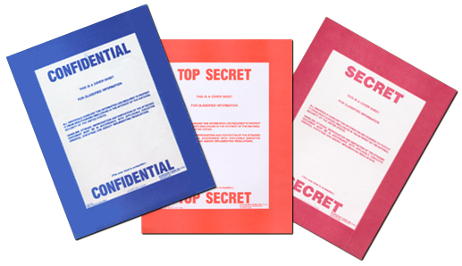
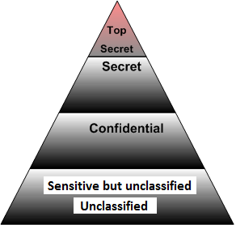
3. Classification of information

Slide 17
Classification of information
Classified information is material that a government body claims is sensitive information that requires protection of
confidentiality, integrity, or availability.
Access is restricted by law or regulation to particular groups of people,
and mishandling can incur criminal penalties and loss of respect.
Documents and other information assets
are typically marked with one of several (hierarchical) levels of sensitivity
e.g. restricted, confidential, secret and top secret.
The choice of level is often based on an impact assessment
governments often have their own set of rules which include the levels,
rules on determining the level for an information asset, and
rules on how to protect information classified at each level.
Notes:
This can be a standalone policy statement or part of a general staff policy.

Slide 18
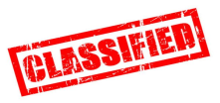
Common classification
The two common classification schemes are
government/military classification and
commercial business/private sector classification.
There are five levels of government/ military classification (listed here from highest to lowest):
Top secret
Secret
Confidential
Sensitive but unclassified
Unclassified

Slide 19
Classification… (1)
Top secret
The highest level of classification.
The unauthorized disclosure of top secret data will have
- drastic effects and
- cause grave damage to national security.
2. Secret
Used for data of a restricted nature.
The unauthorized disclosure of data classified as secret will have
significant effects and
cause critical damage to national security.

Slide 20
Classification … (2)
3. Confidential
Used for data of a confidential nature.
The unauthorized disclosure of data classified as confidential will have
noticeable effects and
cause serious damage to national security.
This classification is used for all data between secret and
sensitive but unclassified classifications.
4. Sensitive but unclassified
Used for data of a sensitive or private nature,
- but the disclosure of this data would
- not cause significant damage.
5. Unclassified
The lowest level of classification.
This is used for data that is neither sensitive nor classified.
The disclosure of unclassified data
does not compromise confidentiality or cause any noticeable damage.

Slide 21
Classification … (3)
The classifications of confidential, secret, and top secret are
collectively known or labeled as classified .
Often, revealing the actual classification of data
to unauthorized individuals is a violation of that data.
Thus, the term classified is generally used to refer to
- any data that is ranked above the sensitive but unclassified level.
All classified data is exempt from the
- Freedom of Information Act as well as
- many other laws and regulations.

Slide 22
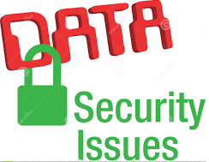
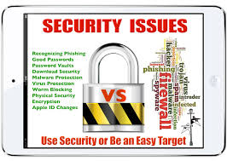
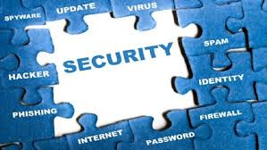
4. Other Security issues

Slide 23
Other Security issues
(a) Ensure that computers, applications, databases and servers using the HRMIS are password protected.
It is recommended that passwords are of sufficient strength to deter password cracking or guessing attacks.
A strong password includes numbers, symbols, upper and lowercase letters and is changed on a regular basis.
(b) After a period of inactivity, ensure that computers are subject to password-protected lock out.
Staffs should ensure that PCs are logged off or ‘locked’ when left unattended for any period of time and user credential is required to access.
(c) Ensure that computers and servers are
- securely locked away from any unauthorised people.

Slide 24
Security issues…
(d) Ensure that access controls are put in place and the correct designated role is assigned to you.
Ideally, users should only have access to the specific data which they require in order to perform their duties.
For sensitive personal data, i.e., racial/ethnic origin, political opinion/adherence, religious/similar belief, membership to trade union, physical/mental health, sexual preferences/practices and criminal convictions,
it is recommended to use additional safeguards such as encryption and multi-level access controls.
(e) Ensure that the security measures in place are
up-to-date and effective, e.g. up-to-date antivirus & firewall software.
Ensure that an up-to-date firewall
is available to protect systems connected to the internet.

Slide 25
Security issues…
(g) Ensure that access to personal information
is restricted on a “need-to-know” basis in accordance with defined policy governing data protection aspects,
e.g., authorisation required when accessing certain modules in the HRMIS.
(h) Ensure that Access granted has been provided to the user
For example to the HRMIS the credentials have been provided to work there.
For instance, swipe card and/or PIN technology to the room(s) in question could be used to record when, where and by whom the room was accessed and to ensure that no one is granted access by others credentials .
Any access to the system which is no longer in active use, and
provides access to personal data in for eg the HRMIS,
should be removed where such access is no longer necessary or cannot be justified.

Slide 26
S 27. DPA - Security of personal data
(1) A data controller shall –
(a) take appropriate security and organisational measures for the prevention of unauthorised access to, alteration of, disclosure of, accidental loss, and destruction of the data in his control; and
(b) ensure that the measures provide a level of security
appropriate to –
(i) the harm that might result from the unauthorised access to,
alteration of, disclosure of, destruction of the data and its accidental loss; and
(ii) the nature of the data concerned.

Slide 27
S28. DPA - Duty to destroy personal data
Where the purpose for keeping personal data has lapsed,
the data controller shall –
(a) destroy such data as soon as reasonably practicable; and
(b) notify any data processor holding such data.
(2) Any data processor who receives a notification
under subsection (1) (b) shall, as soon as reasonably practicable,
destroy the data specified by the data controller.

Slide 28
S 29 DPA.Unlawful disclosure of personal data
Any data controller who,
without lawful excuse, discloses personal data in any manner that is incompatible with the purposes for which such data has been collected shall commit an offence.
(2) Any data processor who,
without lawful excuse, discloses personal data processed by him without the prior authority of the data controller on whose behalf such data is or has been processed shall commit an offence.
(3) Subject to subsection (4), any person who -
(a) obtains access to personal data, or obtains any information constituting such data, without prior authority of the data controller or data processor by whom such data is kept; and
(b) discloses the data or information to another person,
shall commit an offence.

Slide 29
S 29 DPA.Unlawful disclosure of personal data
(4) Subsection (3) shall not apply to a person
who is an employee or
agent of a data controller or
processor and is acting within his mandate.
(5) Any person who offers to sell personal data where such personal data has been obtained in breach of subsection (1) shall commit an offence.
(6) For the purposes of subsection (5),
an advertisement indicating that personal data is or
may be for sale, constitutes an offer to sell the personal data shall commit an offence.

Slide 30
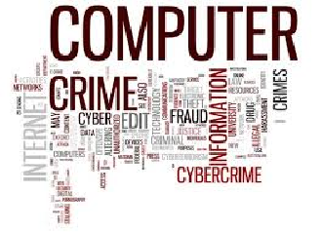
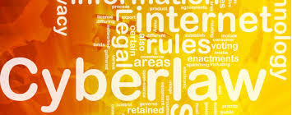
5. Other related laws for Security and safe Keeping of official information

Slide 31
Other related laws for Security and safe Keeping of official information
Data Protection Act
​Computer Misuse and Cybercrime Act
Electronic Transactions Act
Official Secrets Act
Information and Communication Technologies Act
All the above can be downloaded from the internet at:
http://mtci.govmu.org/English/Rules-RegulationsPolicies/Pages/default.aspx
http://dataprotection.govmu.org/English/Pages/default.aspx
http://ethicscorner.govmu.org/English/Documents/Regulatory/secretsact.pdf

Slide 32
