Slide 1
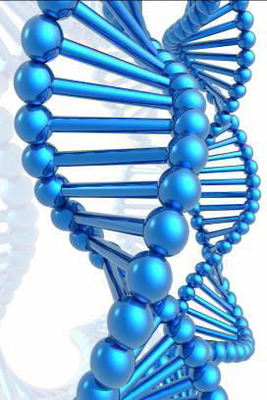
BIOMETRICS , CCTV & DATA PROTECTION
By Drudeisha Madhub
Data Protection Commissioner
Date: 09.07.14

Slide 2
Biometric Data of a Person
All biometric data pertaining to a living individual are “personal data” within the DPA. They include fingerprint, retina, iris, dna, amongst others.
The Data Protection Act applies when use or processing of all personal data are being made.

Slide 3
Applicability of DPA (relevant sections)
Section 22 : Processing for lawful and necessary purpose
Section 23 : Accuracy of data has to be ensured
Section 24 : The express consent of the data subject is required for processing personal data
Section 25: Processing of sensitive data
Section 26 : Keeping for specified purpose(s) & ensuring that the data is adequate, relevant and not excessive

Slide 4
Applicability of DPA (relevant sections)
Section 27 : The organisation as data controller has the responsibility to ensure that the data is safe and secure
Section 28: Data is kept only for a justified duration
Section 29: Unlawful disclosure is not allowed
Section 32: Data Matching

Slide 5
Exemption from DPA
Section 45 : Exemption from DPA application allowed for national security
Section 46 : Exemption to certain sections of the DPA allowed for the prevention or detection of crime by relevant authorities

Slide 6
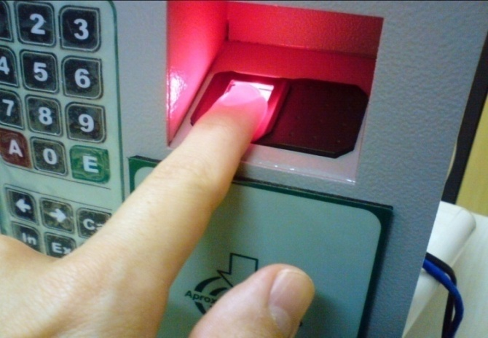
Biometric fingerprint for attendance purposes
Requires consent of individuals unless explicitly provided in the contract of employment and the employee is agreeable, or is required by law or relates to information made public by the employee. In case no consent is received, alternative methods for recording attendance must be provided.
Appropriate security and organisational measures must be implemented to secure the data and counteract the 3 main risks associated with the use of fingerprints namely identity fraud, purpose diversion and data breach occurrence.
Appropriate retention policies must be established e.g what will happen to the data when an employee leaves the organisation?

Slide 7
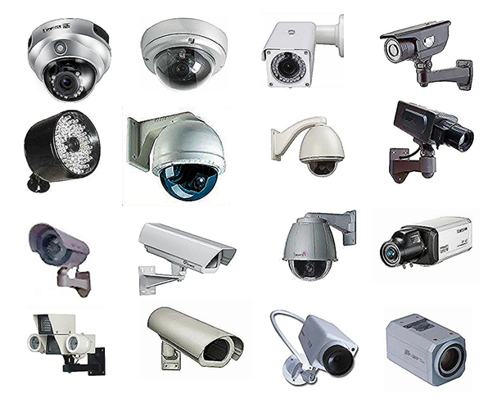
CCTV at work
Images outside the organisation’s premises should not be captured.
Visible and legible signs should be displayed to inform any individual that an area is being covered by CCTV cameras. Such signs should contain:
the purpose/s for which the surveillance is being carried out
the identity and contact details of the organisation.
Images captured must remain secure at all times.

Slide 8
MNIC
THE NATIONAL IDENTITY CARD ACT 2013
Section 12. Collection and processing of data to be subject to
Data Protection Act
The collection and processing of personal data,
including biometric information, under this Act shall be
subject to the provisions of the Data Protection Act.
However, under sections 24 and 25 of the DPA, consent is not required where the data controller is able to show that the processing is required by law or falls under any other exception applicable under these sections.

Slide 9
Best Practices – The Four Part Test
Case to case analysis using the following principles to show that collection is required:
Necessity
Is the measure demonstrably necessary to meet a specific need?
Effectiveness
Is it likely to be effective in meeting that need?
Proportionality
Would the loss of privacy be proportionate to the benefit gained?
Alternatives
Is there a less privacy-invasive way of achieving the same end?

Slide 10
Best Practices - Privacy Impact Assessments
A Privacy Impact Assessment is a process intended to help organisations consider the impact that a new or substantially modified initiative can have on people’s privacy, especially when personal information is being collected. The process is useful for any organisation.
Guideline titled Vol. 6 - Guidelines on Privacy Impact Assessments on http://dataprotection.gov.mu

Slide 11
Thank You

