Slide 1
Training at Civil Status Division
Training on Data Protection
Presented By: Mrs Dodah Pravina
Mr Reza Mukoon
Date : 21 August 2014

Slide 2
Data Protection Act
AN ACT
To provide for the protection of the privacy rights of individuals in view of the developments in the techniques used to capture, transmit, manipulate, record or store data relating to individuals

Slide 3
Definitions

Slide 4
Definitions
Data
means information in a form which –
(i) is capable of being processed by means of equipment operating automatically in response to instructions given for that purpose; and
(ii) is recorded with the intent of it being processed by such equipment; or
b) is recorded as part of a relevant filing system or intended to be part of a relevant filing system;

Slide 5
Definitions - ctd
Personal data means –
(a) data which relate to an individual who can be identified from those data; or
(b) data or other information, including an opinion forming part of a database, whether or not recorded in a material form, about an individual whose identity is apparent or can reasonably be ascertained from the data, information or opinion;

Slide 6
Examples of Personal Data
Name of individual
Address
Car No
Telephone No
Bank account no

Slide 7
Definitions - ctd
Sensitive personal data
Sensitive
Racial/Ethnic Origin
Political Opinion /
Adherence
Religious /
Similar Belief
Membership to Trade Union
Physical / Mental Health
Sexual Preferences /
Practices
Criminal Convictions

Slide 8
Definitions – ctd
Processing means any operation or set of operations which is performed on the data wholly or partly by automatic means, or otherwise than by automatic means, and includes -
collecting, organising or altering the data;
retrieving, consulting, using, storing or adapting the data;
disclosing the data by transmitting, disseminating or otherwise making it available; or
aligning, combining, blocking, erasing or destroying the data;

Slide 9
8 principles of Data Protection Act

Slide 10
Data Protection Principles
First Principle
Personal data shall be processed fairly and lawfully

Slide 11
Data Protection Principles
Practical steps
For example, if an organisation is collecting personal data using application forms, the organisation is advised to explain the purposes/uses etc. on such forms such as:
This data will be used by the organisation for xxxx purposes.
All personal data will be processed in accordance with the Data Protection Act 2004.
I agree/disagree that the organisation processes my personal data in the way described above.

Slide 12
Data Protection Principles
Second Principle
Personal data shall be obtained only for any specified and lawful purpose, and shall not be further processed in any manner incompatible with that purpose.

Slide 13
Data Protection Principles
Practical steps
Prepare a statement of the purpose/purposes for which the organisation holds information about others.
Remember: Any individual has the right to ask the organisation to state the purpose/s for which such information is kept.

Slide 14
Data Protection Principles
Third Principle
Personal data shall be adequate, relevant and not excessive in relation to the purpose for which they are processed

Slide 15
Data Protection Principles
Practical steps
Decide on specific criteria by which to decide what is adequate, relevant, and not excessive.
Apply those criteria to each information item and the purposes for which it is held.

Slide 16
Data Protection Principles
Fourth Principle
Personal data shall be accurate and, where necessary, kept up to date

Slide 17
Data Protection Principles
Practical steps
Assign specific responsibility for data accuracy under the Data Protection Act and arrange periodic review and audit.

Slide 18
Data Protection Principles
Fifth Principle
Personal data processed for any purpose shall not be kept longer than is necessary for that purpose or those purposes

Slide 19
Data Protection Principles
Practical steps
Assign specific responsibility to someone for ensuring that files are regularly purged and that personal information is not retained any longer than necessary.

Slide 20
Data Protection Principles
Sixth Principle
Personal data shall be processed in accordance with the rights of the data subjects under this Act

Slide 21
Data Protection Principles
Under section 41 of the Data Protection Act, on making a written request to a data controller, any individual about whom a data controller keeps personal information on computer or in a relevant filing system is entitled to:
a copy of his/her data upon payment of the prescribed fee (Rs 75),
whether the data kept by him include personal data relating to the data subject,
a description of the purposes for which it is held;

Slide 22
Data Protection Principles
Seventh Principle
Appropriate security and organisational measures shall be taken against unauthorised or unlawful processing of personal data and against accidental loss or destruction of, or damage to, personal data

Slide 23
Data Protection Principles
Practical steps
Compile a checklist of security measures for your own systems.
In addition, where an agent is being retained to process personal data on behalf of the organisation, there should be a sound contractual basis for this, with appropriate security safeguards in place.

Slide 24
Data Protection Principles
Eighth Principle
Personal data shall not be transferred to another country, unless that country ensures an adequate level of protection for the rights of data subjects in relation to the processing of personal data

Slide 25
Data Protection Principles
Authorisation is required from the Data Protection Commissioner to transfer data abroad
Organisation must fill and submit to this office the ‘Transfer of Personal Data Form’ available on http://dataprotection.gov.mu

Slide 26
Disclosure

Slide 27
Disclosure of information
An organisation must ensure that personal information in its possession is not disclosed in any manner incompatible with the purposes for which such data has been collected, which is an offence under section 29 of the Data Protection Act.

Slide 28
Disclosure of information
The principle is that the prior consent from the concerned data subject should be obtained before any disclosure is made, unless the exceptions under section 24(2) of the DPA are applicable in the circumstances as follows:
For the performance of a contract to which the data subject is a party and/or;
For compliance with any legal obligation to which the organisation is subject.

Slide 29
Data Sharing

Slide 30
Data Sharing
The organisation who owns the personal data, i.e. the data controller, is responsible for the personal data in his custody
As per section 24(1) of the Data Protection Act, the express consent of the data subject is required before sharing can be done and the data subject should be informed of that at the time of collection of the personal data according to section 22 of DPA

Slide 31
Data Sharing
However, as per section 24(2) of the Data Protection Act, personal data may be processed without obtaining the express consent of the data subject where the processing is necessary:
for the performance of a contract to which the data subject is a party;
in order to take steps required by the data subject prior to entering into a contract;
in order to protect the vital interests of the data subject;
for compliance with any legal obligation to which the data controller is subject;
for the administration of justice; or
in the public interest.

Slide 32
Data Sharing
In the absence of sections 24(1) and 24(2) of the Data Protection Act and any legislation/act which authorises the data to be shared, amendment to existing legislation/act is required to allow the sharing to be done.

Slide 33
Data Sharing
Whenever data sharing is taking place, the data controller(i.e the organisation who owns the data) has to ensure that organisational and technical measures are in place to protect the data being shared.

Slide 34
Data Sharing
Further information may be obtained in the guideline : Vol. 9 - Practical Notes on Data Sharing Good Practices for the Public and Private Sector, which is available on our website at http://dataprotection.gov.mu/English/Documents/Publications/Guidelines/Data_Sharing.pdf.

Slide 35
Data Security

Slide 36
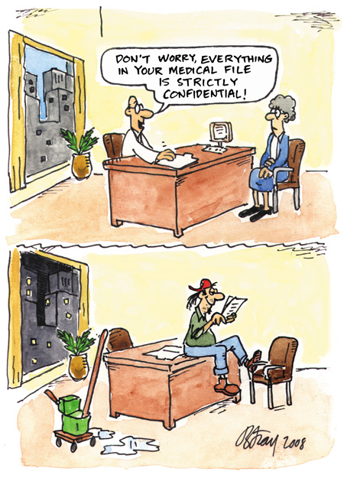
Risk
Image Source: Office of Privacy Commissioner (OPC)

Slide 37
Threats to Data Privacy
Identity Theft
Data Breach

Slide 38
Identity Theft
Identity theft occurs when someone uses your personally identifying information, like your name, social security number, or credit card number, without your permission, to commit fraud or other crimes.

Slide 39
Data Breach
A data breach is an incident in which sensitive, protected or confidential data has potentially been viewed, stolen or used by an individual unauthorised to do so.

Slide 40
Best Practices

Slide 41
Employee or End User Education
All relevant security policies must be clearly explained to staff
A clear explanation of the consequences for violating these policies must also be explained.
The end user needs to sign a document acknowledging that they understand the policies and consequences for violating these policies.

Slide 42
Standards
Data Security is subject to several types of audit standards and verification
Example ISO 27001/27002 : ISMS
Security Administrators are responsible for creating and enforcing a policy that meets the standards that apply to their organisation’s business.

Slide 43
Data Classification
Data needs to be classified in the security policy according to its sensitivity.
Once this has taken place, the most sensitive data requires extra measures in place to safeguard and ensure its integrity and availability.
All access to sensitive data must be logged.

Slide 44
Physical / Technical Controls
Physical access must be controlled to the data center or area where the data is stored.
Access control lists must be implemented to define which user needs what type of access on which data.
Encryption of data is recommended for transmission of data across networks.

Slide 45
System and Network Security
The use of firewalls to protect against intrusions.
Shutting down unused switch ports.
If wireless is deployed, use authentication servers to verify and log the identity of those logging on.
Anti-Virus and malicious software protection on all systems.

Slide 46
Guideline titled ‘Vol 10 - Protecting the Confidentiality of Personal Data by Government Department(s)’ available on http://dataprotection.gov.mu under publications

Slide 47
Thank You

