Slide 2
IS OUR DATA SAFE IN THE DIGITAL ECOSYSTEM ?
Presented by the Data Protection Commissioner
on 30.04.14

Slide 3
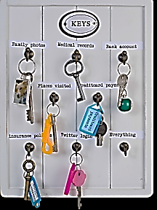
Data Protection
At its core, data protection is about preserving a fundamental right that is reflected in the Charter of Fundamental Rights of the European Union, Council of Europe Convention 108, as well as other international agreements and national constitutions.
The economic value of citizens’ data has outweighed the importance of protecting this fundamental right.

Slide 4
Data Protection
Personal data means information (a single piece of information or a set of information) that can identify an individual or single them out as an individual.
The obvious examples are somebody’s name, address, national identification number, date of birth or a photograph. A few perhaps less obvious examples include vehicle registration plate numbers, credit card numbers, fingerprints, IP address (e.g. if used by a person rather than a device, like a web server), or health records.

Slide 5
Data Protection
Identifiers are also used to trace individuals.
For instance, online advertising companies use tracking techniques and assign a person a unique identifier in order to monitor that person’s online behaviour, build their “profile” and show offers that could be relevant for this person. Such an advertising company does not need to know that the person in question is Mrs Madhub– it is enough to know that user 12345678 repeatedly visits certain websites, “likes” certain websites, etc.

Slide 6
Data Protection
Processing reliable data contributes to reducing waste of resources and improve policy-making.
Citizens are increasingly aware that they are being constantly “watched” by public authorities and private entities. This challenges their trust in both, particularly as electronic data collection is often done invisibly. This growing lack of trust is damaging for democracy and for business.

Slide 7
Data Protection
If data are the new currency or the new oil, we need to learn the painful lessons of the banking industry – weak regulation and excessive faith in the market will led to catastrophic loss of trust, with consequences for every single citizen.
A strong and intelligent approach to creating a value-driven set of practices on data collection, processing and sharing, together with adequate rules protecting citizens against short-sighted (though understandable) business interests is both necessary and inevitable. In the long run, citizens and democratic societies as well as businesses can only profit from strong safeguards.

Slide 8
With anonymisation-problem still not solved?
YOU ARE NOT A NUMBER.
Effective anonymisation has not been achieved. Transparency regarding the technologies being used, open peer review by security engineering experts and responsible disclosure procedures provides early warnings over compromised databases and raise standards.

Slide 9
The Purpose Limitation Principle
USE FOR STATED PURPOSE/S ONLY
This purpose must be properly defined and communicated to the person (“data subject”) whose data are being processed. This permits the data subject to know what will happen to his/her personal data.
For example, when you buy a product online, a company may keep your personal information on file in order to send you marketing messages – unless you object to that. It may also use your purchase history data in order to improve its communication to you, even though you provided your data only to buy a product.

Slide 10
The Purpose Limitation Principle
USE FOR STATED PURPOSE/S ONLY
The law states that personal information may not be used for purposes that are incompatible with the original purpose of data processing. That means that certain uses of data are off-limits. For instance, selling personal data of users to another company or institution (without first getting the data subject’s authorisation), or combining the data with data obtained from other sources in order to build up that customer’s profile.

Slide 11
Consent to Data Principle
WITH YOUR PERMISSION
Consent to processing of personal data must meet a number of requirements in order to be valid.
In the first place, consent must be explicit. Putting consent wording in general terms of use, or asking users to click a button saying “I agree” without supplying the necessary information is not sufficient. Pre-ticked boxes that users have to un-check are also not a valid method of expressing or obtaining consent.

Slide 12
Consent to Data Principle
WITH YOUR PERMISSION
Secondly, consent must be specific and well-informed. The purposes of the processing must be clear and users must really understand which of their data are being processed. They must also understand the consequences of the processing and how this may affect them in the future.

Slide 13
Consent to Data Principle
Finally, consent must be given freely. This criterion implies that a user has a real choice to consent to processing.
To sum up, consent should always be meaningful in order to be valid, and with the criteria that consent must be freely given, specific, informed and explicit, users can actually be in a position to give such a meaningful consent.

Slide 14
Big Data
INDUSTRIAL RAW MATERIAL
The Gartner group defines Big Data as “high-volume, high-velocity, and/or high-variety information assets that require new forms of processing to enable enhanced decision making, insight discovery and process optimization.”
This can also be expressed as using unprecedented processing power to extract hidden layers of information from masses of “ordinary” data pulled from a variety of different sources.

Slide 15
Data Security and Data Breaches On The Rise
HANDLE WITH CARE
The amount of personal information being held in computer systems has increased dramatically – not just because of technical improvements, but also because of the emergence of user-generated systems such as online social networking and Web 2.0.

Slide 16
Data Protection by Design and by Default
BUILT WITH PRIVACY AS STANDARD
It is increasingly important to ensure that privacy protections are built into the design and implementation of the products and services. This is the concept of data protection by design and by default.

Slide 17
Data Protection by Design and by Default
Allowing everyone the opportunity to consciously choose the privacy setting that they feel most comfortable with – rather than the service provider making a guess about what they might prefer.
Service providers should support their users in this by providing user-friendly methods to change privacy settings. They should also be transparent about their data processing practices and supply understandable privacy policies.
The key is for users to be in control – how much you share should be your choice, and not a choice made for you by the service provider.

Slide 18
Privacy and Data Protection on Social Network
Participating on a social network by using a pseudonym (a name that is not directly connected to your legal name) is one way to achieve limited additional protection of your privacy. If users are not happy about the service or the way the company deals with their data, they should be empowered to move all their information away from that service – this is called the right to ‘data portability’. Easy transfer of data will increase competition, consumer choice and innovation.
Also, terms of service agreements should be clear and easy to understand so users can make informed decisions about which platforms to use.

Slide 19
Cloud Computing
PREDICTABLE PROTECTION IN AN UNPREDICTABLE ENVIRONMENT
Cloud services can bring many benefits to users, particularly convenience and flexibility, reduced costs, ease of use, improved access to online content, and automatic maintenance and updating. However, there are also important worries which center on control of the data and their geographical location. Who has access to them? How can they be used? How easy is it to move the data from one cloud service to another? How secure are they? Who is responsible if the data are lost or misused?

Slide 20
Profiling is about Guessing
USING PERSONAL DATA TO GUESS AT PREFERENCES
There are three main problems with profiling:
The algorithms are not designed to be perfect, and the rarer the activity they are used for, the higher the risk of mistakes. In simple terms: profiling should never be used in relation to characteristics that are too rare to make them reliable, nor to make significant decisions about individuals.
Profiling is likely to perpetuate and reinforce societal inequality and discrimination against racial, ethnic, religious or other minorities.
Profiling algorithms can be so complex that even the organisations using them are no longer able to understand their logic. In fact, they might not even try or be able to understand that logic at all, particularly because the algorithms are often protected as “trade secrets”. There is a serious risk of unreliable and (in effect) discriminatory profiling being widely used, in matters of real importance to individuals and groups, without the required checks and balances to counter these defects.

Slide 21
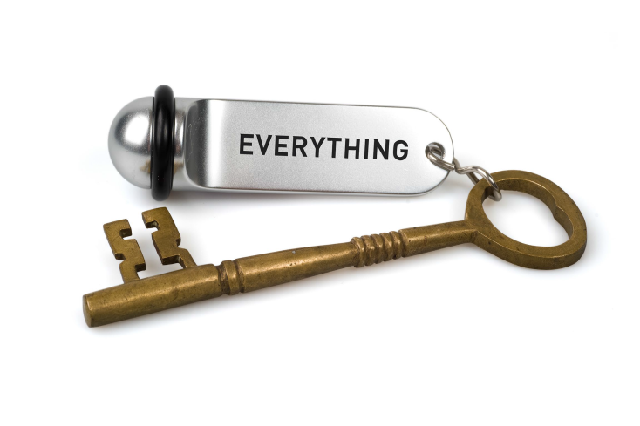
Making It Work
A GOOD LAW NEEDS GOOD ENFORCEMENT

