Slide 1
Forensic Investigation Techniques

Slide 2
STORM Cyber.Care
Assess | Plan | Respond
Full Service offering for Reinsurers, Insurers,
Brokers and Clients.
Assess
Lightweight cyber risk assessments to enable clients to learn
and improve their cyber security and to enable insurers and
reinsurers to manage book risk.
Forensic Investigation Techniques
Plan
Helping insured clients to create, learn (through training) and
exercise/test their plans in dealing with different types
of cyber incidents in the context of their business.
Respond
Delivering a fully coordinated and Integrated Cyber
Incident Response Team (I-CIRT).

Slide 3
Investigation: Revealing the Picture
What?
Was Compromised
Was/is Potential Impact
Who?
Was Targeted
Where?
When?
Detected?
Compromised?
Controls Failed
Why?
Criminal Theft
Error
Other Criminal
Non-Criminal
How?
Method of Attack
Body of Evidence
Severity
Priority
Organisation
3rd Party
Staff Home
Mobile
Attacker Location
Staff Involved
3rd Parties Involved
Was Responsible
Attacker type
Location/Identity
Incident Type
Affected Systems Location
Data Went
Was it Stopped

Slide 4
Technical response objectives
Triage of breach
Analysis of the incident “Indicators of Compromise” (IoC)
Halt the spread or worsening of the compromise and limiting the impact
Digital forensics and testing to investigate the cause and effects of incident/breach
Recover when needed:
Clear existing environment or establish new environment in preparation for recovery
Restore all systems and business data to operational readiness
Implement more effective controls and make whole any compensating controls
Post-incident reporting and analysis

Slide 5
Incident Stats
129 incidents in last 12 months: range of types and size of victim org.
Mailbox hijacking – BEC
Significant Rise in targeted fraud
Ransomware/Extortion
Advanced malware incidents increasing
Data Theft: PII and other digital assets
Diverse causes and types of incident – some not actual breaches
Range of Impacts: sometimes significant loss – increasing BI
Increasing regulator scrutiny: GDPR – 72 hour window
4

Slide 6
The BEC Analysis Challenge
Business Email Compromise an extremely simple attack
Starts with Phishing; usually from trusted parties, aim: steal login credentials
Attackers use credentials to hijack users online mailbox(es)
Mailbox rules are often used to hide activity and assist the criminals
Main aim of the hijack is to detect and manipulate payment instructions
In the process, (often) significant PII is accessible and downloaded
Downstream risk of attacker extortion with threat to release news of breach
GDPR/MU DPA requires notification of all data subjects who may be at ‘high risk’ as a result of the data breach
As part of our investigation we need to inform the client about:
Sensitive data which may put data subjects at ‘high risk’ e.g. fraud & ID theft
Identify all data subjects to inform the notification activity
5
Notes:
Notable US stats for 2016

Slide 7
The BEC Analysis Challenge
Mailbox data is highly unstructured and not easily searchable for PII
Often there are many Gigabytes of data from many years of activity
It is not just messages & attachments…
Calendar entries (with attachments), Tasks & Contacts
Files (OneDrive & SharePoint)
Automated searching is used extensively with our forensic toolset and without losing the overall evidential integrity often risked with e-Discovery tools
Often, sensitive data is contained within scanned documents (images) which cannot be reliably searched.
Scanned documents include passports, driving licenses, ID records, agreements, bank statements etc.
6
Notes:
Notable US stats for 2016

Slide 8
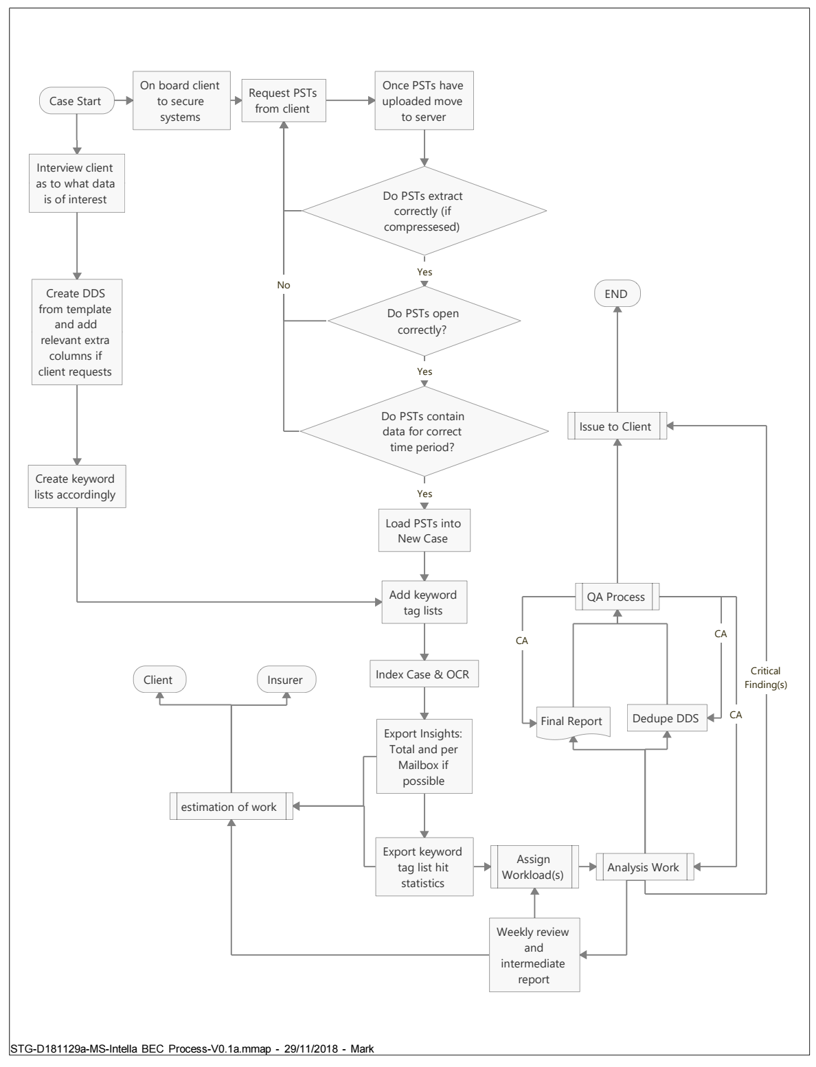
The BEC Analysis Challenge
The BEC Analysis Steps
Extract mailbox(es) into standard file format for forensics tool
Load the mailbox(es) into the forensics tool and perform indexing function
Run initial analysis report and share results
Initiate build of spreadsheet tool
Arrange search terms (more of which may be added dependent on findings during analysis)
Run search terms and enhance with Boolean expressions where necessary to exclude FNs and reduce FPs
Manually verify results on searches returning key sensitive information including image files of note
De-duplicate
Report
Carve out items of interest for legal consideration
7
Notes:
Notable US stats for 2016

Slide 9
The BEC Analysis Challenge
Considerable manual effort is therefore needed to:
Contextualise email discussion threads to determine risk
Read and classify image files
Dismiss false positives generated by automated searches
Carve out message attachments for review by legal specialists
Record data found against data subjects to assess risk in the aggregate
create a register of the affected data subjects so as to aid legal advice around risk, and enable suitable notification responses if required.
8
Notes:
Notable US stats for 2016

Slide 10
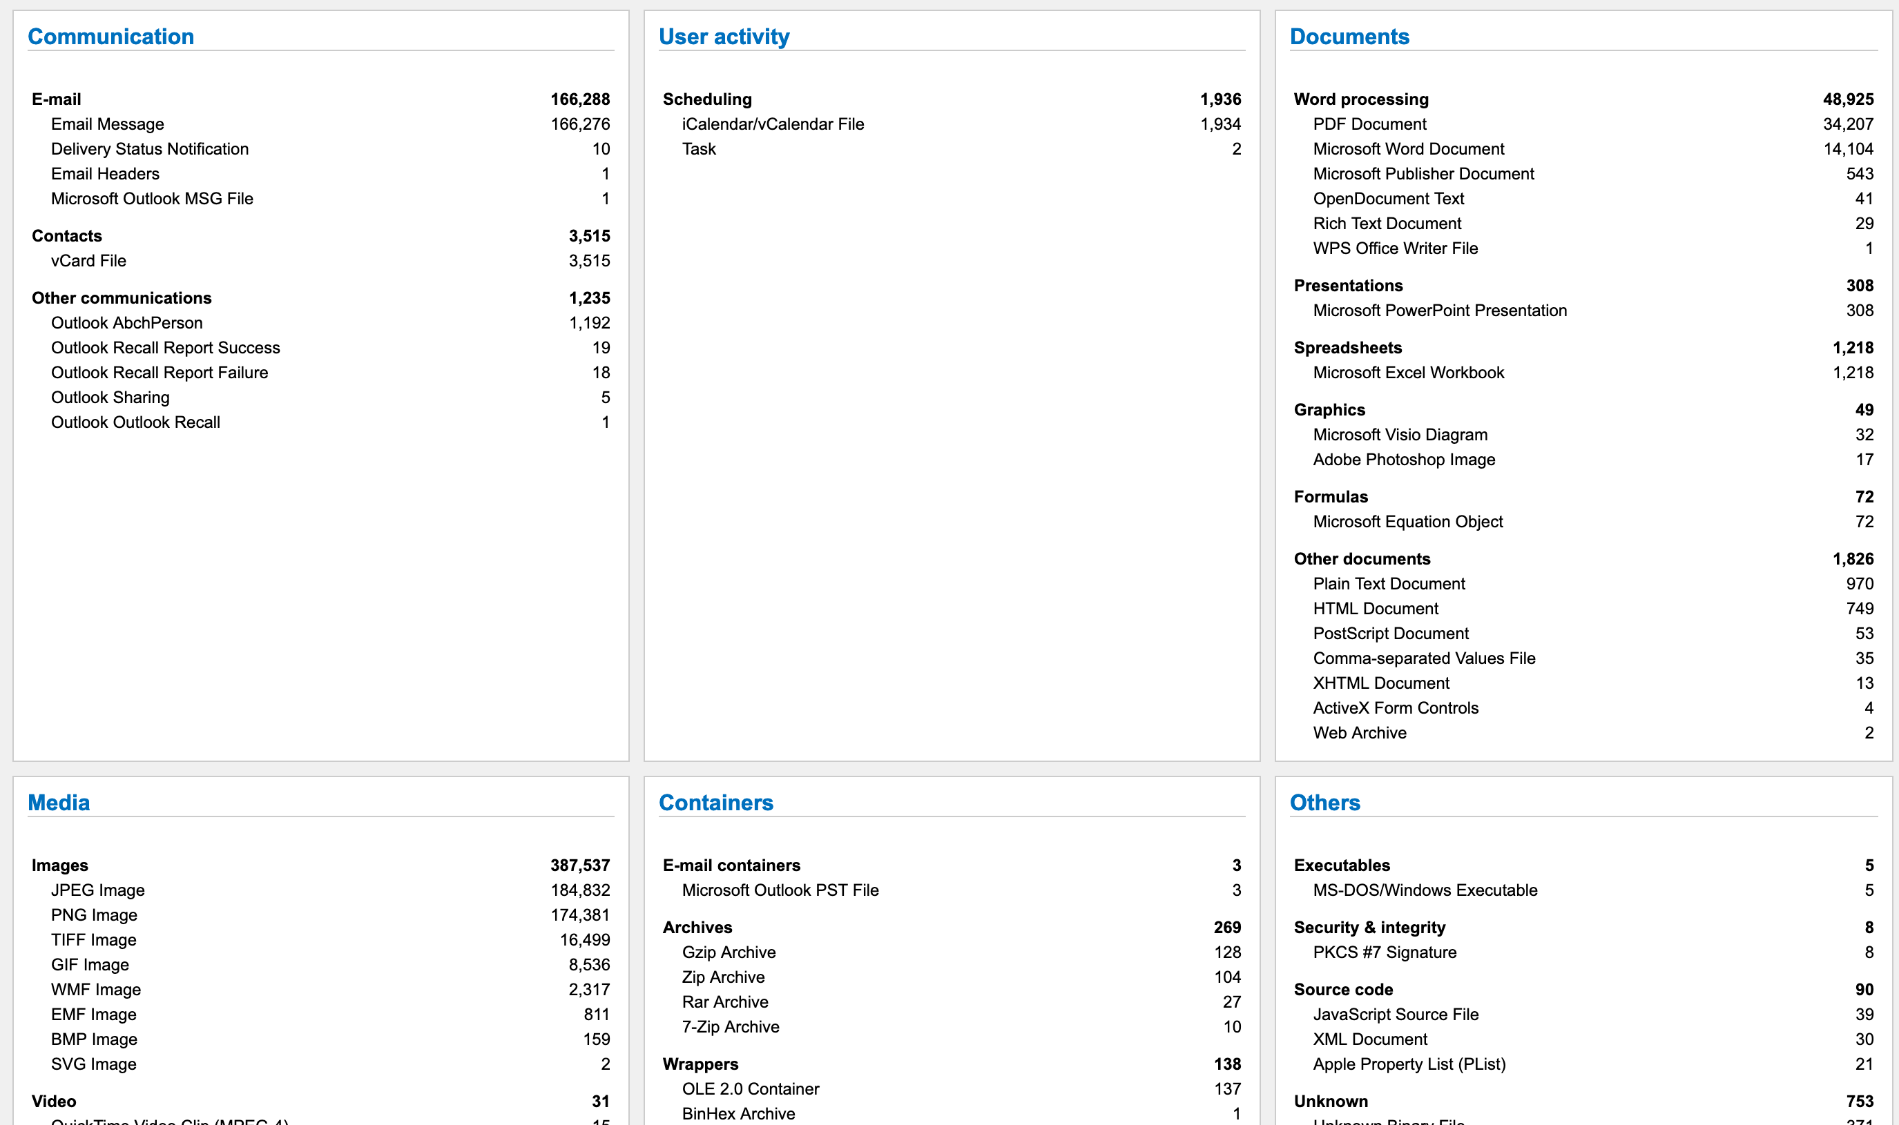
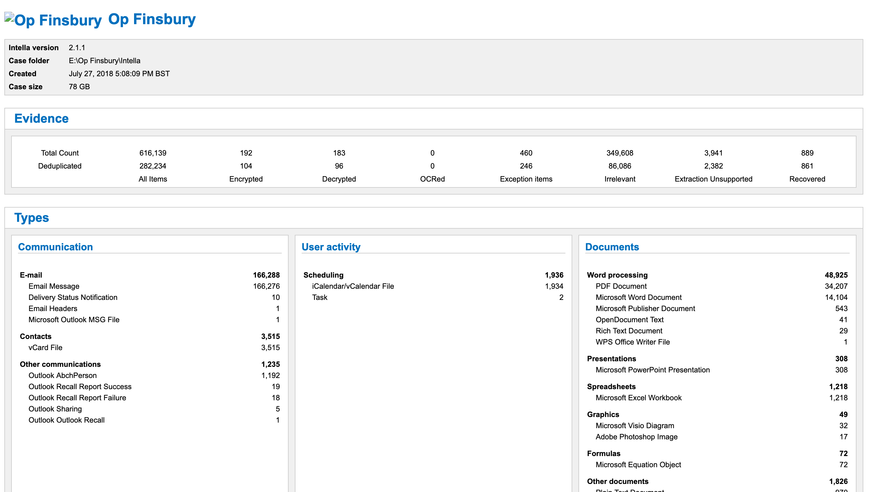
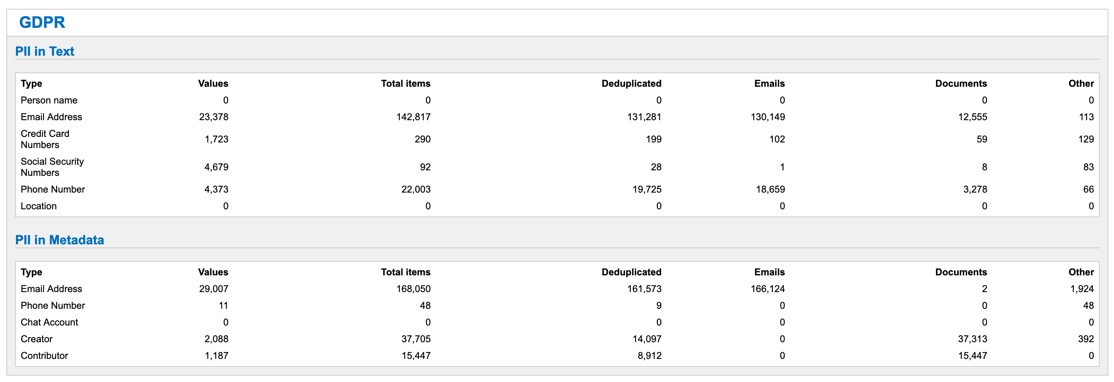
The BEC Analysis Challenge
9
Notes:
Notable US stats for 2016

Slide 11
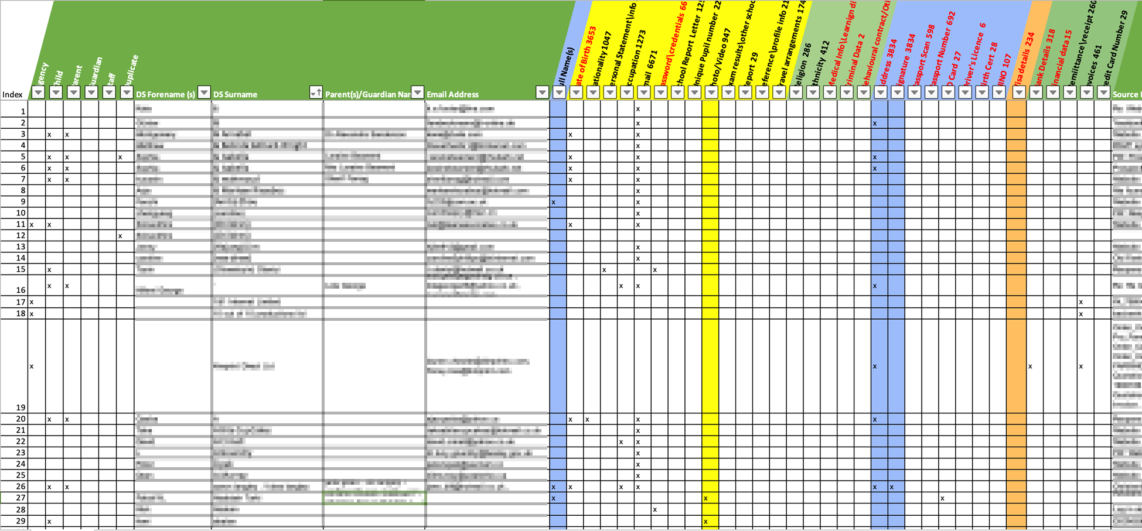
The BEC Analysis Challenge
Findings totals
De-duplication
10
Notes:
Notable US stats for 2016

Slide 12
STORM BEC Analysis Process
Request Client complete Mailbox Analysis Questionnaire for each mailbox
Assist Client in advice on export
Receive the Mailbox in PST format
Verify the PST (PST viewer - check that it opens, check date range to confirm all mailbox or incomplete/limited extraction
Load into e-Discovery platform & run indexing process
Run Insight report: Share with client and discuss estimated time to complete
Run searches (Pre-defined Search Lists)
11

Slide 13
STORM BEC Analysis Process
Need to select search terms (within selected lists) to maximise accuracy and minimise false positives - called ‘alignment’.
Randomly select results and check alignment.
Make modifications to improve the alignment
Grade and group search term results into Batches for analysis (200-300 search results per batch).
Results of batch analysis is transcribed into the DDS spreadsheet.
De-duplicate the DDS spreadsheet
Design and execute the Notification exercise driven from the DDS
12

Slide 14
What to Expect in 2020
Further rise in reported incidents
Specific rise in mailbox hijacking – BEC
Unless Microsoft make Multi-Factor Authentication (MFA) mandatory
Further advanced Ransomware attacks with data exfiltration
Extortion from historic Data Thefts – threat intel important
Rise in sophisticated malware (called RAT) assisted frauds
Continued focus on social engineering scams
Renewed drive to reduce fraud opportunities
Banks to include account name in transaction integrity checks
Better email analysis and mailbox threat/phishing detection
13

Slide 15
Thank you
Neil Hare-Brown

